Slide 1
Conflict, change and social movements
How influential are social media and digital communications in driving change?

Slide 2
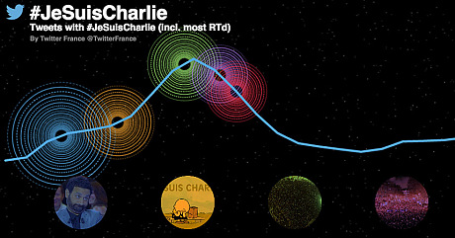
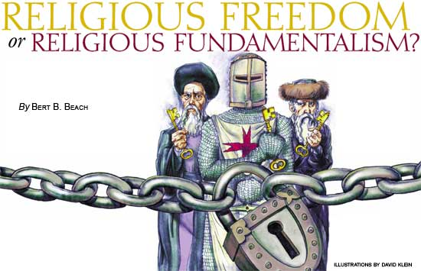
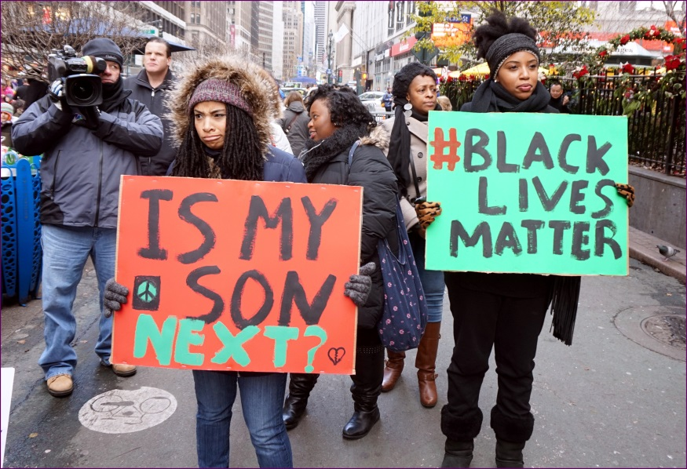
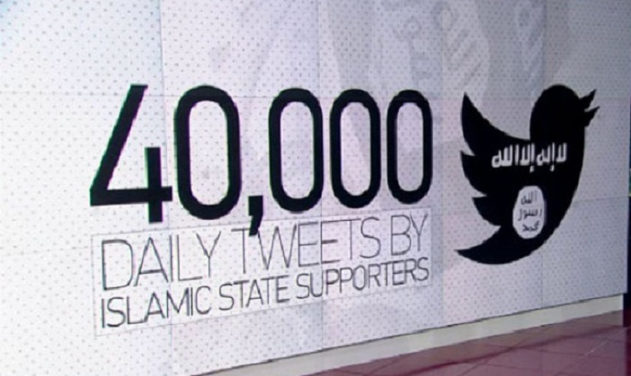
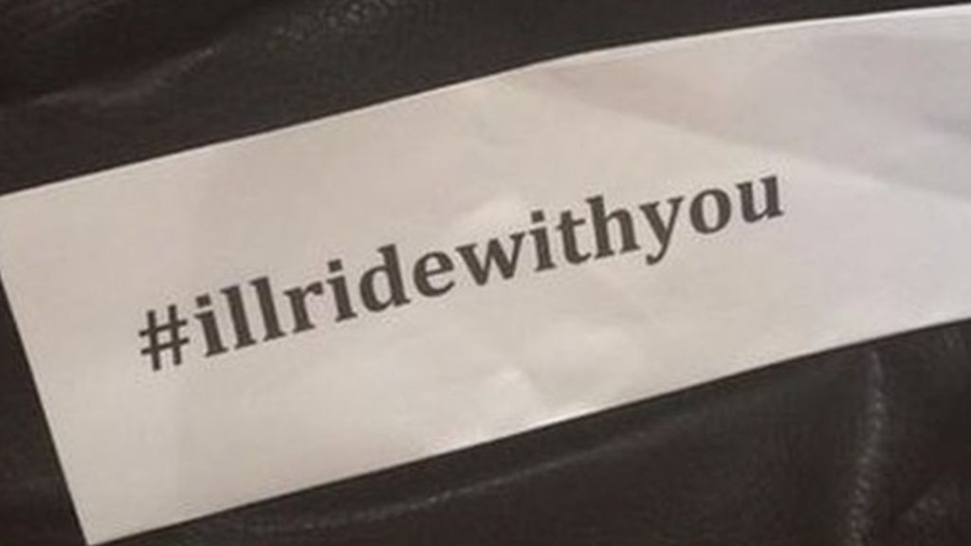

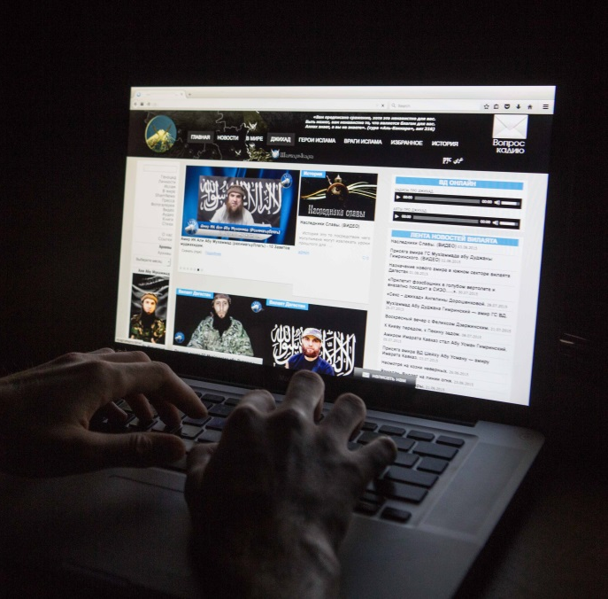

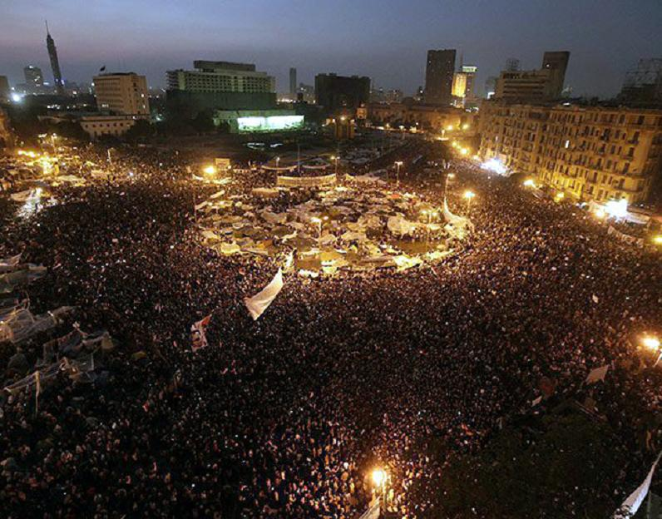

Slide 3
Do we think that social media and digital communications drive change?
Can you think of any online campaigns? Or social movements who have used this type of communication to take action?
How successful are they? How do they go about it?
2011 riots
The Arab spring – especially Egypt
Terrorist groups e.g. ISIS – especially recruitment and spread of propaganda.
Post Brexit alliance
Occupy
#reclaimtheinternet
Anonymous
38 degrees and other such online petition platforms
#blacklivesmatter
#illridewithyou
#jesuischarlie
Any other you can think of – just run it past me.

Slide 4
Your task..
…is to research one such group in pairs and present your findings to the class.
This will also give you a set of contemporary examples to use in any exam questions.
Focus on groups who specifically use social media and digital communications:
The method they use to communicate or influence
The process - i.e. what they actually do, events etc.
The impact

Slide 5
Present your findings to the class
Whilst you listen to each other fill out the table provided and use as examples in exams and essays.
We will also try to apply some theoretical explanations to what we hear.
What might a Marxist, feminist or postmodernist (or anyone else) say?

Slide 6
Homework
Read and annotate the Jurgenson and Joyce articles. Pick out the key points relating to this topic.
Take notes from your textbook.

