Slide 1
What social class do you feel yourself to belong to?
Discussion Question:
How do you define your social class?
Do you feel that your social class matters?

Slide 2
Stories in the media
Class and Educational Success
Social Class determines Success
Education and Class
Schools 'to drop nationality questions'

Slide 3
Sociological Targets
To understand that class can have an influence on school attainment.
To recognise that traditional patterns of class attainment are resistant to change.
To identify some of the factors that may contribute to the class patterns of attainment.

Slide 4
Do a 30 second sketch of either
A working-class person
A middle-class person
An upper-class person
Discuss
Why have these characteristics changed very little in 50 years?
What characteristics do you need to do well at school?

Slide 5
What are the effects of social class on educational attainment?
There is a relationship between parental occupation and education and children’s success or failure in school

Slide 6
Government definitions of class (2001)
Social Class |  | Typical employment
Higher Managerial occupations | 1.1 | Company directors, Police Inspectors, Bank Managers, Senior Civil Servants, Military Officers
 | 1.2 | Doctor, Barrister, Solicitor, Clergy, Librarian, Teacher
Lower Managerial | 2 | Nurses and midwives, Journalists, Actors, Prison Officers, Police and Soldiers (below NCO)
Intermediate | 3 | Clerks, Secretaries, Driving Instructors, Computer Operator
Small employers | 4 | Publicans, Farmers, Play group leader, Window cleaner, Painter and Decorator
Lower supervisory and craft | 5 | Printers, Plumbers, Butchers, Bus Inspectors, TV engineers, Train drivers
Semi-routine occupations | 6 | Shop assistant, Traffic Warden, Cook, Bus drivers, Hairdressers, Postal workers
Routine occupations | 7 | Waiters, road sweepers, Cleaners, Couriers, Building labourers, Refuse collectors
Never worked | 8 | Long term unemployed and non-workers

Slide 7
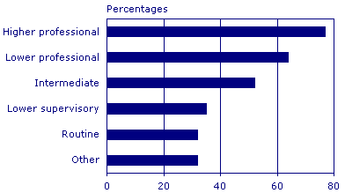
Attainment of top GCSE grades by parental occupation

Slide 8
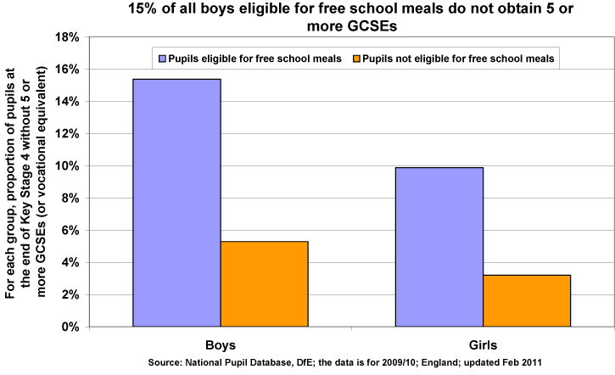

Slide 9
Is this a problem?
What does this tell us about ‘meritocracy’?
Why do we need to tackle the problem?
What are the causes of underachievement. Is it culture or is it the schools ?

Slide 10
 | Home | School
Culture | The culture of the working class leads to school failure | The culture of schools disadvantages the working class
Deprivation | Working class children do not have the material possessions that they need for success | Schools in working class areas are underfunded and under-resourced

Slide 11
Why is this debate important ?

Slide 12
Use these phrases to explain these two points of view using further details from the lesson
Failure of working classes is due to their home life because………………..
Failure of the working classes is due to the school system………………….

Slide 13
Sociological Targets - Plenary
To understand that class can have an influence on school attainment.
To recognise that traditional patterns of class attainment are resistant to change.
To identify some of the factors that may contribute to the class patterns of attainment.

Slide 14
Assessment
Outline and explain the relationship between social class and educational attainment in the UK.

Slide 15
Essay Plan
Outline the patterns that exist and that there are two possible explanations for these patterns (material and cultural ) suggest which perspectives would support these two explanations
Material explanations (Home and school) it is linked to poverty and resources in certain areas, deprivation at home but also lack of resources in schools. (Marxist)
Cultural explanations (Home and school) it is linked to the upbringing of working-class children and the middle-class culture of schools disadvantaging some children. (Functionalist/New Right)
Conclude with a summary of the explanations and which one you think is better.

