Slide 1

Socialization
Importance of socialization
Development of self identity
and social interaction
Agents of socialization
Resocialization
Socialization and social change
Notes:
The material on resocialization and socialization and social change appears on the second set of slides titled Socialization Part Two on the Online Notes page.

Slide 2

Importance of socialization
Essential for individual survival
  lifelong process
  nature vs. nurture
Essential for a society’s survival
  transmission of values, norms, culture
  effects of inadequate socialization
Notes:
Biosociology maintains that human behavior in primarily the result of genetic influences and physiology. For example, male aggression has been linked to higher levels of the hormone testosterone. Therefore, biosociologists would say that males are inherently more aggressive than females and that this is a positive trait from an evolutionary standpoint because the more aggressive males would have been most likely to survive and acquire mates thus passing their aggressive genes along to their descendents. I suppose the gentle males all got wiped out….
Well that’s the nature viewpoint in a nutshell- the nurture viewpoint would not deny the impact of biology on behavior but proposes that human behavior is much more complex than can be explained by raging hormones and that the influence of socialization far out weighs the impact of biology. Males may have testosterone, but they learn to be aggressive and they can also learn to be compassionate.
Humans are social primates. You have read about Harlow’s experiments with monkeys and about the effects of social isolation on children.
The socialization process transmits society’s values, norms, and culture to the young. Without this society itself would cease.

Slide 3
Socialization is needed and occurs because humans:
  have no instincts and so must learn everything
  have a long period of infant dependency
  have a need for social contact
  have the ability to learn and
  the capacity for language
Notes:
Most social scientists agree that, while biology does influence some portions of our personalities, human beings have no instincts. They bear artricial young- the newborns are incapable of caring for themselves. In the case of humans this dependency lasts up to 20 years (socially anyhow), perhaps longer. Sociologists therefore maintain that the self we develop is a result mainly of our social circumstances.

Slide 4
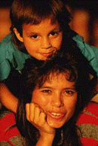
Development of Self
The development of self takes place within social contexts.

Slide 5
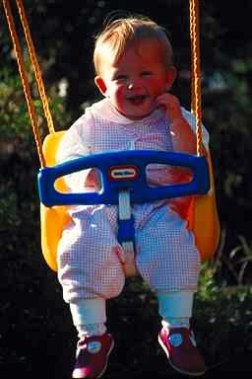
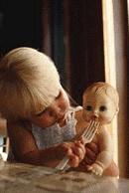
Interactionist Perspective:
George Herbert Mead
First two Stages of development:
  1. preparatory =
  imitate
2. play =
pretend
Notes:
“I” is the subjective self; “Me” is the objective self.
We are born with the I & acquire the Me.
The generalized other: awareness of society’s and group’s norms and values.
Mead is not specific about ages when each stage takes place. His schemata is more open than those of Erickson, Piaget, Kholberg. However, by elementary school, children have begun to be able to place themselves in the shoes of others, a skill which then develops in organized, supervised activities.

Slide 6
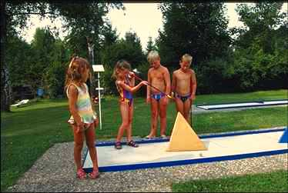

Stage 3: Learn to Role Take with The Generalized Other
3.Game stage=
organized activities & games in a group
  context
Role taking with the
generalized other

Slide 7
Role Taking
Essential to learn to role take with the generalized other in order to be fully socialized.
  Role taking is an empathetic process of putting oneself in the place of others.
  What if the person cannot role take with the generalized other or other people?

Slide 8
Agents of Socialization
SCHOOLS
PEERS
FAMILY
MEDIA

Slide 9

Family
Most important agent
Primary group
Infancy to 5 or 6
Provides:
  social position
  emotional support
  physical support
  role models
Notes:
What is a primary group?
What is a secondary group?
In which of these do we send most of our adult lives?
The period from infancy to about five years is the most important time in our lives for socialization. We learn more during this time span than during the entire rest of our lives. We start out at birth knowing nothing. By the time we are 5 we can speak, write (some), count, tie our shoes, walk. . . . .
We learn values as well during this time.

Slide 10
Socialization and Social Class: Melvin Kohn Study:
Blue Collar Working Class
material rewards &
punishments
communication as command
child figures out what parents want
stress on obedience
White Collar “Middle” Class
symbolic rewards & punishments
communication as interaction
parents figure out what child wants
stress on autonomy
Notes:
Kohn’s study indicated that working class parents and middle class to upper middle class white collar families raised their children with different emphases.
These are ideal types, of course, and no one family will have all of either of these lists of characteristics. Rather, most families will be a “mix’ of both of these. However, working class families and middle class white collar families do exhibit different patterns. The blue collar parents are accustomed to taking orders at work. Therefore, they stress commands, obedience, etc. They are raising their children to go into a workplace where, to be successful and keep a job, their children will have to take orders. The white collar parents, on the other hand, work in an environment that stresses communications, creativity, and values autonomy; they may have to talk back to the boss to benefit the business. So their children are raised to be more independent,etc. This will then benefit those children when they grow up and enter a white collar workplace.
In a society in which technical competence and higher education results in better jobs, more and more parents are beginning to emphasize autonomy. This is functional for a Post Industrial society which needs workers ready to take risks such as changing professions several times, going back to college to be re-educated, starting their own businesses, learning new technologies.
Please remember to read about: Conflict theory maintains socialization “reproduces the class system.” In other words, ascribed status, education and occupation, networks, role expectations, endogamy interact such that people create new families very similar to the family in which they were raised.

Slide 11
Mass Media & Socialization
Types of mass media:
  movies, television
  print- magazines and newspapers, books, etc.
  music
  electronic communications
Notes:
For the purposes of class discussion:
the American Academy of Pediatrics notes that children as young as 2 are spending, on average, 16 to 17 hours in front of the television every week; children, on average, view about 10,000 violent acts on television each year. The Academy has further recommended that children under the age of 2 watch no television.

Slide 12
Functions to socialize:
  provides information
  contact with others
  viewpoints on issues
  access to consumer culture
  entertainment
  education?
Positive and negative aspects
Notes:
While we are accustomed to complaints that children (or adults) watch too much television, a new mass media problem has emerged since 1994- Internet Addiction. The American Psychiatric Association has recognized Internet Addition Disorder. Some indications include:
1.Tolerance- needing more time online to achieve satisfaction.
2. Withdrawal symptoms that develop within a few days to a month after reducing or stopping use. The resumption of use decreases the symptoms.
3. Use of the Internet more often for longer periods of time. And spending time on Internet related activities (reading books, trying out software, etc.)
4. Neglect of other important life activities.
5. Excessive use impacts negatively on job, relationship, or other role obligations.
Some research has indicated that middle aged women and people already prone to depression and bipolar disorders are most likely to develop this disorder. The subject has been studied by psychologists. See:
http://www.apa.org/releases/internet.html
http://www.chem.vt.edu/chem-dept/dessy/honors/papers/ferris.html
http://rdz.stjohns.edu/~storm/iad.html
The Center for On-Line Addiction http://netaddiction.com/offers empirical research and includes a survey you can take online to see if you are affected. And on a lighter note, there’s the site Internet Junkies Anonymous which offers a 12 step program online. http://members.aol.com/Iainmacn/addicts/
What sociological explanations could there be for this disorder?

