Slide 1
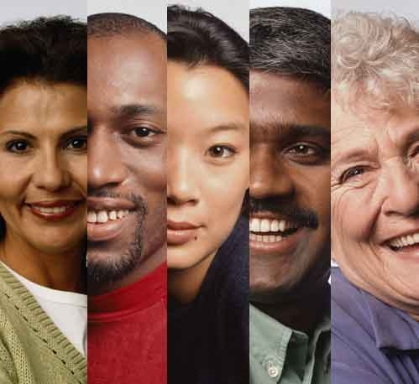
UNDERSTANDING IDENTITIES AND DIVERSITY

Slide 2
IDENTITY IS ABOUT:-
Sameness and Difference !
WHO WE ARE
GROUPS WE BELONG TO
HOW WE DESCRIBE OURSELVES
HOW OTHERS SEE US
Gender, ethnicity, class, age, race, nationality.

Slide 3
DIVERSITY IS ABOUT THE MANY DIFFERENCES THAT EXIST BETWEEN GROUPS AND INDIVIDUALS.
BRITAIN IS A DIVERSE SOCIETY WHICH BRINGS MANY BENEFITS AND SOME CHALLENGES.
Write a response to the question ‘Who am I?’ 5 minutes

Slide 4
WHO AM I ?
Things you might think of:-
NAME
NATIONALITY
WHERE YOUR FAMILY ARE FROM
AGE
GENDER
RELATIONSHIPS – SON, MOTHER ETC
THINGS YOU LIKE
WHAT YOU LOOK LIKE
WHERE YOU LIVE?
SCHOOL/LOCAL COMMUNITY
THINGS YOU DO – JOB/HOBBIES
GROUPS YOU BELONG TO – CLUBS, CHURCH ETC
INTERESTING THINGS ABOUT YOU

Slide 5
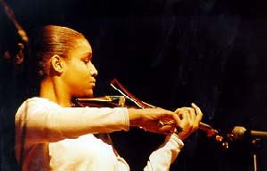
PERSONAL IDENTITIES
WHAT IS UNIQUE TO YOU?
Jenkins (2004) Distinguishes between individual and collective identities.

Slide 6
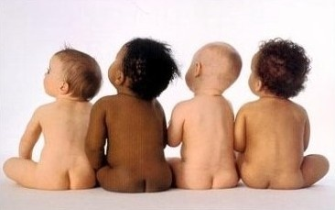
SOCIAL IDENTITIES
WHAT THINGS ABOUT YOU DO YOU SHARE WITH OTHERS?
THESE COULD BE GROUPS OF PEOPLE TO WHICH WE FEEL WE BELONG SUCH AS GENDER/RELIGION/RACE/NATIONALITY
/MUSIC LOVERS !
THESE ALSO TELL US WHICH GROUPS WE
DO NOT BELONG TO.

Slide 7
Use handouts to complete examples
Social identities
Personal Identities

Slide 8
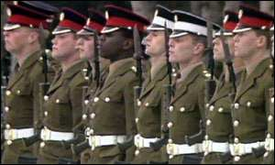
THINK ABOUT WHAT YOU SHARED WITH OTHERS:
ARE YOU EXACTLY THE SAME AS THOSE PEOPLE?

Slide 9
Theories of how identity is formed
George Herbert Mead – Human development involves imagining how others see us. Cooley called this ‘The looking glass self’ Therefore identity links to the external world and how we are portrayed by others.
Erving Goffman – The social world is like a play in which we play a part to present ourselves in particular ways.
Sigmund Freud – Childhood experiences are vital in development of identity in adulthood, especially sexual and gender identities.

Slide 10
Free-will Vs Determinism
Structural perspectives like Marxism, Functionalism and Feminism would say that identities are imposed upon us and that we have no choice.
What do you think ?

Slide 11
WHO DO YOU WANT TO BE?
Identities can change
Post-Modernists believe that we now have a lot of freedom to choose our identities through joining different sub-cultures or buying goods to suit a lifestyle.

Slide 12
How do roles link to our status?
Ascribed statuses are imposed upon us
Examples
Achieved statuses are gained through effort or talent.
Examples
Do we have the freedom to influence these in any way?

Slide 13
IDENTITIES ARE:-
ABOUT BELONGING
COMPLEX AND MULTIPLE
INDIVIDUAL
SHARED
NOT FIXED

Slide 14
Check Terms
Social identities
Personal Identities
Looking-glass self
Roles
Diversity
Notion of other

