Slide 1
Writers within the interpretive or interactional tradition of sociology are interested in the processes within schools which lead some children to failure.
How do processes within school affect educational attainment?

Slide 2
Sociological Targets
To understand how interactions between schools and pupils can affect pupil progress.
To evaluate interactionism as a theory.
To use sociological evidence and research to support your judgements.

Slide 3
Master status
A person's master status is the most obvious thing about that person.
It controls the way they are identified in public.
The master status becomes a label we attach to people.

Slide 4

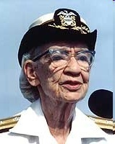


What do you see first?

Slide 5
How does this apply to school?
The self fulfilling prophecy and labelling theories explained

Slide 6
Self-fulfilling Prophecies
This occurs when our beliefs and expectations create reality
Our beliefs and expectations influence our behaviour and others’
‘Pygmalion’ effect

Slide 7
Teacher has expectations
Sees child in negative way
Sees child in positive way
Child rejects teacher
Child fails
Child succeeds

Slide 8
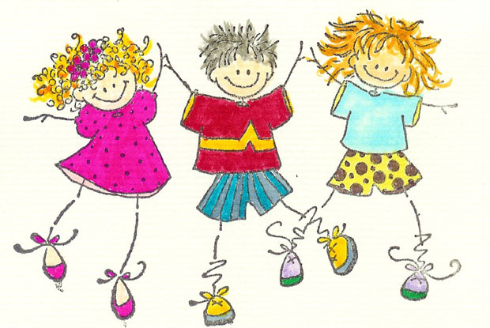
Stupid
Nice person
Naughty
Clever
Lazy
Good at art
Lousy at maths

Slide 9
Sticky Labels and Scenarios
Sticky labels are hard to shift they include:- Disruptive student, not very able, very bright, show off, attention seeker
Using the labels on your fellow students come up with scenarios where the student will be misunderstood.

Slide 10
How does it work?
Working class children seen as poor learners
Become victims of the self-fulfilling prophecy
Take on the role expected, leaving the middle classes to dominate the top sets

Slide 11
Rosenthal & Jacobson (1964)
Went to a school and did IQ tests with kids and told teachers that the test was a “spurters” test
Randomly selected several kids and told the teacher they were “spurters”
Did another IQ test at end of year, “spurters” showed significant improvements in their IQ scores
It is argued that this is because of their teachers’ expectations of them
https://www.youtube.com/watch?v=hTghEXKNj7g

Slide 12
Evidence for …
Children in low sets do tend to do less well than children in higher sets; so upper sets in comprehensive schools tended to do better than lower sets in grammar schools.
Children with low self-confidence do less well

Slide 13
Evidence against …
The study was unethical and cannot be repeated.
The methodology was not reliable
Teachers could not remember the names of the ‘spurters’
The theory is not well supported by the statistics in the study

Slide 14

Despite the obvious problems with the study, it has been very influential and still forms part of the professional study for teachers.
The theory was repeated by Schools minister, Lord Adonis in 2006

Slide 15
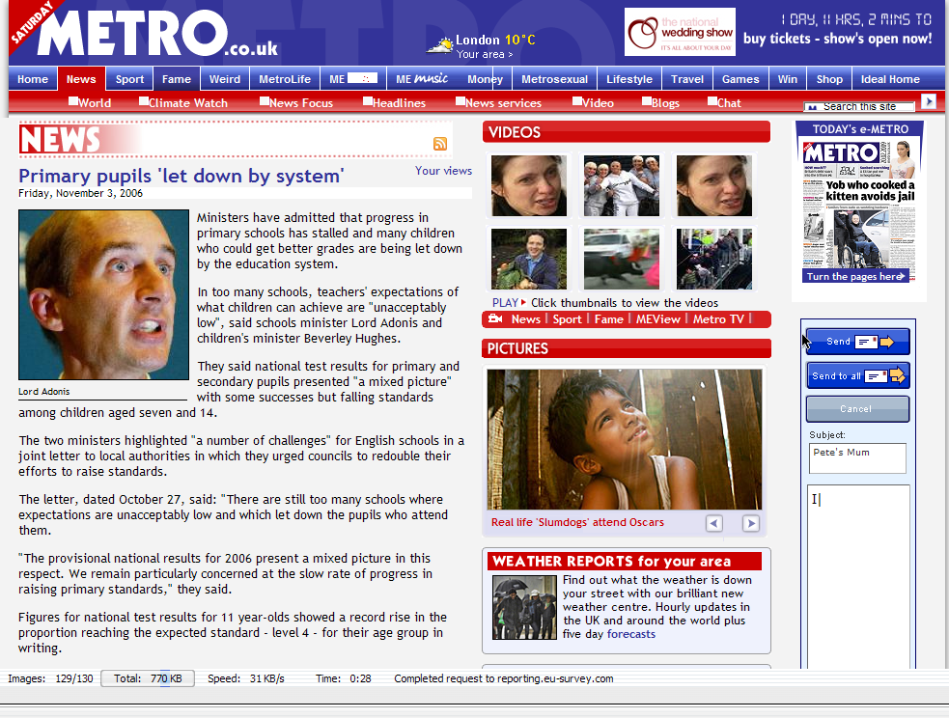

Slide 16
Cicourel and Kitsuse (1971)
Conducted a study in a school in the USA and
Discovered that a pupil's social class was an important influence when being assessed.
Even if children from a working-class or a middle class background were of similar ability, those from the middle class were put on more advanced courses.

Slide 17
Hargreaves (1975)
The success of labelling is dependent on other factors such as:
how often the label is used,
does the pupil accept and respect the teacher's opinion,
do other teachers support the label, and
is the label used publicly or privately?

Slide 18
Further evidence against …
Heidi Safia Mirza in Young, Female and Black found young black girls often did well in school to spite teachers.
We don’t have to accept labels; students can and do reject labels because people are reflexive.

Slide 19
Interactionism
Criticisms
Tend to ignore where class differences originate
Generally focus on small scale studies e.g. individual schools
Tend to ignore factors outside the school
Students do not always accept labels given to them and consequently a self fulfilling prophecy is not a foregone conclusion

Slide 20

Revision
Create learning cards for the following terms
Self-fulfilling prophecy
Master status
Interactionism
Labelling theory
Anti-school subculture
Resistance
Teacher expectations
Ethnomethodology

Slide 21
How useful are interactional theories to an understanding of working class underachievement in education?
Criteria for success
  Outline interactionism
  Explain the evidence for working class underattainment
  Assess the strengths of labelling theory
  Assess the weakness of labelling theory
  Refer to AO1 knowledge about the educational system of the UK
  Use the concepts of sociology
  Refer to studies, writers or theory in your answer.
  Use evaluative language in your answer

Slide 22
Essay Plan – Outline and evaluate how factors inside schools affect attainment (40)
Intro – Sociologists are interested in how education affects the attainment of some students e.g working class, genders, ethnic groups. Factors identified are ….Labelling, setting, Hidden curriculum, institutional racism and competition between schools.
AO2 However these factors ignore the influence of cultural and material deprivation which stems from home.
Outline interactionism and labelling theory - Becker - link to education
AO2 Give criticisms including comparison other factors outside of school e.g material and cultural deprivation and marxism.
Outline evidence which supports labelling theory – Rosenthal and Jacobson
AO2 Evaluate the study using criticisms and other evidence e.g Mirza, Cicourel, Hargreaves.
Outline Hidden curriculum Marxist view – Bowles and Gintis
AO2 give some criticisms e.g are teachers all bourgeiosie? Compare to Functionalist view of Meritocracy
Outline New Right policies which may affect e.g A-C economy setting and league table. Or use institutional racism in schools affecting ethnicity and achievement. McKnight says New Labour policies have been effective.
AO2 Criticise using marxist view of working class children in lower sets – correspondence theory, cultural capital or cultural deprivation e.g Bernsteins elaborate speech code. FSM meals are indicator of poor ofstead
Summarise and suggest which has more effect home or school.

