Slide 1
Meritocracy
The Uk Education system gives every student the same opportunity to do well. If they do not do well it is due to attitudes or intelligence – Therefore the system is fair.
Imagine this scenario- what are the problems
4 students all have similar intelligence are going to have a test on the achievements of Premier League football clubs in the South of England
Student No 1 is dyslexic (boy)
Student No 2 has just moved to the country (girl)
Student No 3 is tired, hungry and upset (boy)
Student No 4 is son of PE teacher

Slide 2
What can you recall about functionalism?
Try and write down at least three things.
If you get stuck, share ideas with a partner

Slide 3
Writers in the structural functionalist tradition of sociology claim that the education system is a meritocracy and that the education system exists to allow the most talented students through to fill the most important jobs in society. Your current task is to assess that claim and to support your arguments with evidence
What do functionalists tell us about education and differences in attainment?

Slide 4
Sociological Targets
To understand functionalist views of education.
To evaluate those views.
To use sociological evidence and research to support your judgements.

Slide 5
Personal targets
To write an essay length answer
To contribute to whole class discussion in an orderly fashion
To think critically about sociology explanations of inequality in education

Slide 6
What is functionalism?
Functionalism is a consensus view of society.
Functionalists believe that society is like an organism (organic analogy), with different parts fulfilling different roles to ensure survival of the whole.
Functional sociologists tend to look at the mechanisms within society in order to understand their functions for that society.

Slide 7
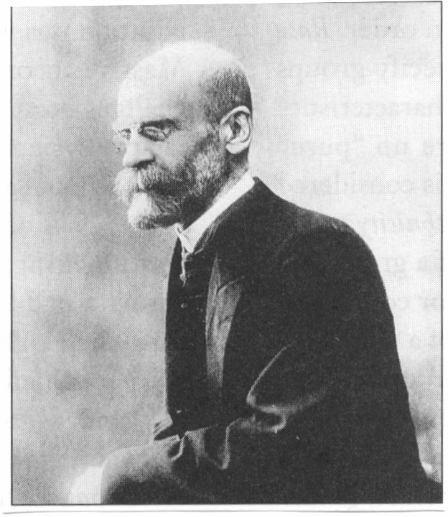
Emile Durkheim
Emile Durkheim was one of the founders of sociology.
He believed we need schools to help us to feel part of society.
We learn social rules and social roles in schools.
Schools sort out people for the most appropriate jobs for their skills and abilities.

Slide 8
What is meritocracy?
Functionalist say the education system acts as a ladder of opportunity for people to achieve the best that they can, according to their ability.
The best people go on to gain the best jobs and become the leaders of their society.
This belief is known as meritocracy.

Slide 9
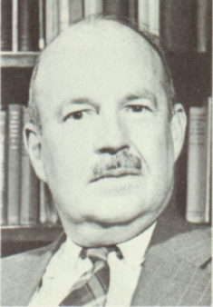
Talcott Parsons
Talcott Parsons is a well-known American theorist.
Parsons developed Structural-Functionalist theory.
Parsons suggests schools are an agency of secondary socialisation.
They train children to accept the norms and values of wider society.
They act to select which children will be trained for the top jobs in society.
They teach children that the system is fair and equal to all.

Slide 10
Davis and Moore (1945)
Inequality is necessary and universal because all societies have inequalities.
If inequality exists, then it must be because it is for the good of society.
This justifies the high pay and status of the richest people in society.

Slide 11
What is evaluation?
Evaluation is the process of judging the value of a research project, an idea or a concept, using further concepts, studies and theories to support the judgement that is made.
Strengths and weaknesses are identified in an evaluation

Slide 12
What are the strengths of functionalism?
It points to links between and within social institutions in society
It emphasises the importance of socialisation within schools
It influences New Right thinking and research

Slide 13
And the weaknesses?
It justifies inequality
There is little supporting evidence
People do not all share norms and values
It ignores structural inequalities such as racism, sexism and social class

Slide 14
A famous challenge
Alvin Gouldner wrote in the 1970s at the height of student rioting against the Vietnam War.
He said:
According to Parsons, people who do not fit in are deviant.
How come it was most intelligent students who were deviant enough to complain about the war, the lack of equality and who challenged traditional ways of thinking?

Slide 15
Outline and assess functional views of education.
Criteria for success
Outline functionalism
Outline what the theorists say
Assess the strengths of functionalist thinking
Assess the weakness of functionalist thinking.
Refer to AO1 knowledge about the educational system of the UK
Use the concepts of sociology
Refer to studies, writers or theory in your answer.
Use evaluative language in your answer

Slide 16
Outline the meaning of the term Meritocracy (equality of opportunity)
Explain the term
Reasons why education is meritocratic
Counter-argued with reasons why it is not meritocratic
Meritocracy is a Functionalist idea
Marxists would argue it is a myth
Use evidence ! Keywords ! And don’t forget your AO2s

