Slide 1
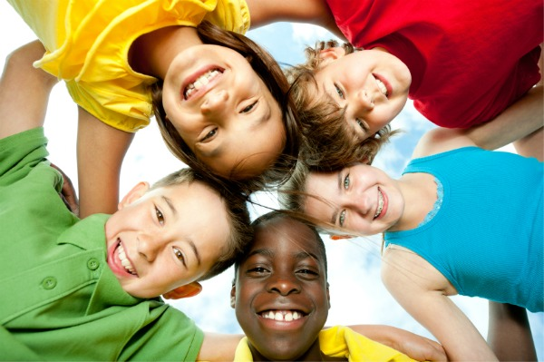
Culture and Cultural Identity
Teachersofcolor.com

Slide 2
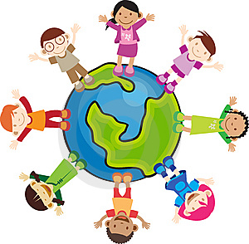
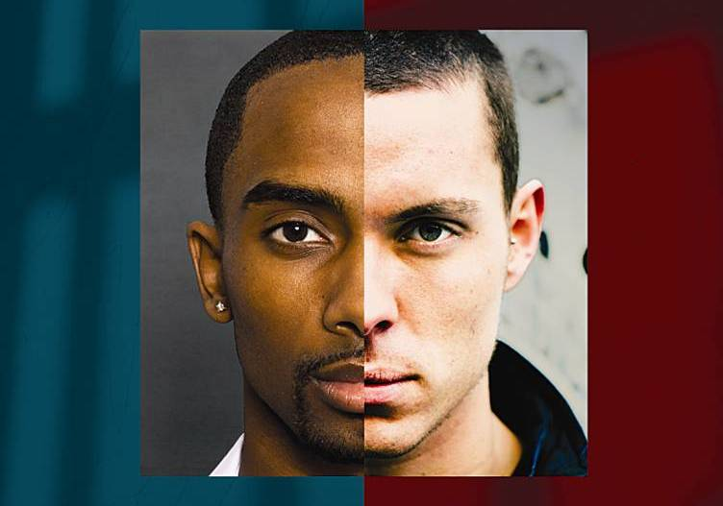
Cultural Identity
Voices.com
The self-image that we derive from our family, culture, ethnicity, and society around us (Ting-Toomey)
Sitesmid.edu

Slide 3
Social Identities Racial Identity – a classification system used to categorize individuals into large and distinct populations Ethnic Identity – derived from a sense of shared heritage, history, traditions, values, area of origin, and sometimes language National Identity – the nation/country one was born into ( or a sense of place) www.tolerance.org/tdsi/sites/tolerance.../UIR_Identity_PPT_WIN.ppt

Slide 4
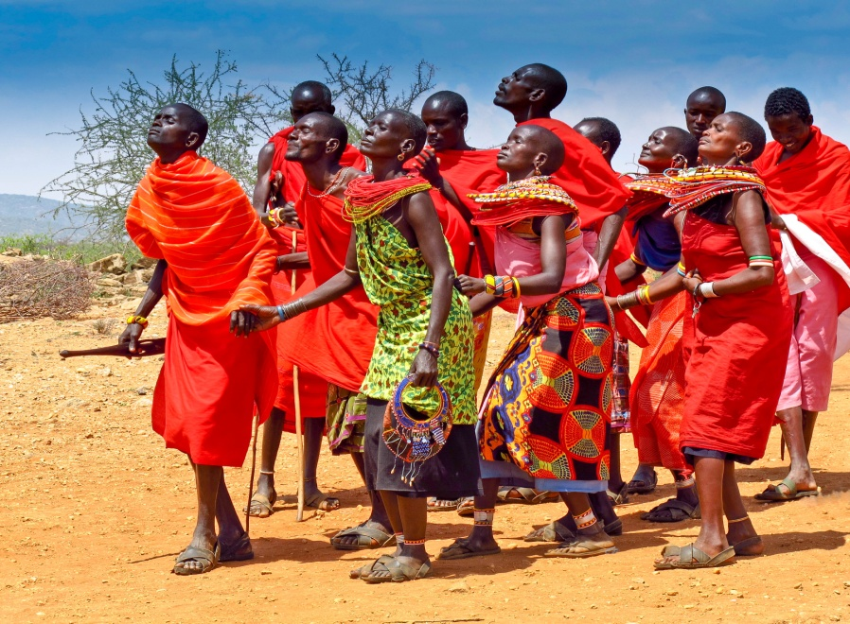
Difference Between Traditions and Customs
A tradition is a behavior or belief passed down in a group from generation to generation. For example, celebrating birthdays.
A custom is a behavior that is habitual, but not necessarily passed down. For example, eating dinner at six in the evening.
Afridance.com

Slide 5
The Dark Side of Identity Stereotypes- categorization into a particular group of people. “Everyone fits into the same mold.” Prejudices – are deeply held negative feelings associated with a particular group (anger, fear, aversion, anxiety). Racism – an extension of stereotyping and prejudice. The belief that one race is inherently superior to another Ethnocentrism – one’s own culture is superior to any other.
facweb.northseattle.edu/chamilton/CulturalID.ppt‎

Slide 6
Who am I?
Nationality
Physical
Appearance
Traditions…
Family
Language
Values
Multiple Identities

Slide 7
Who am I?
What is my name?
Where do I live?
Where was I born?
Where is my family from?
What nationality am I?
What ethnicity am I?

Slide 8
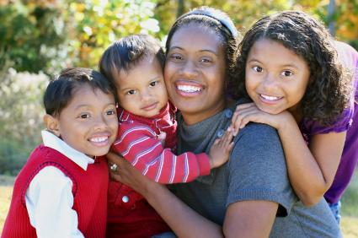
How do my relationships with others shape me?
How has my family influenced me?
How have my peers influenced who I am?
Flfamily.org

Slide 9
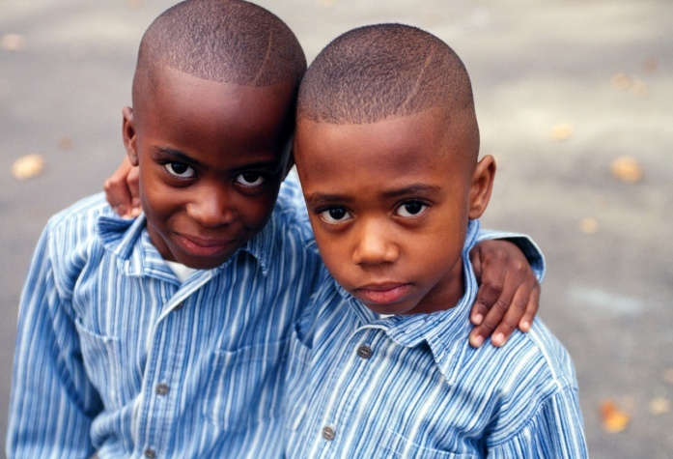
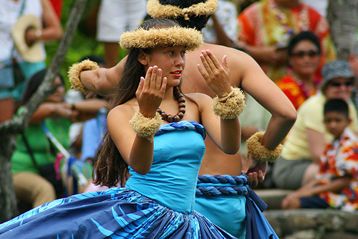
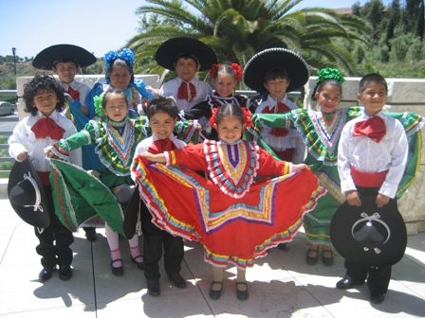
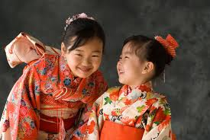
How do I fit into a nationality, ethnicity, and racial group?
Race?
me
Nationality?
Ethnicity?
Usarmy.com
Healthzone.com
Portaloha.com
Soka niversity.edu

Slide 10
Who am I?
What nationality am I?
What ethnicity am I?
What race am I?

Slide 11
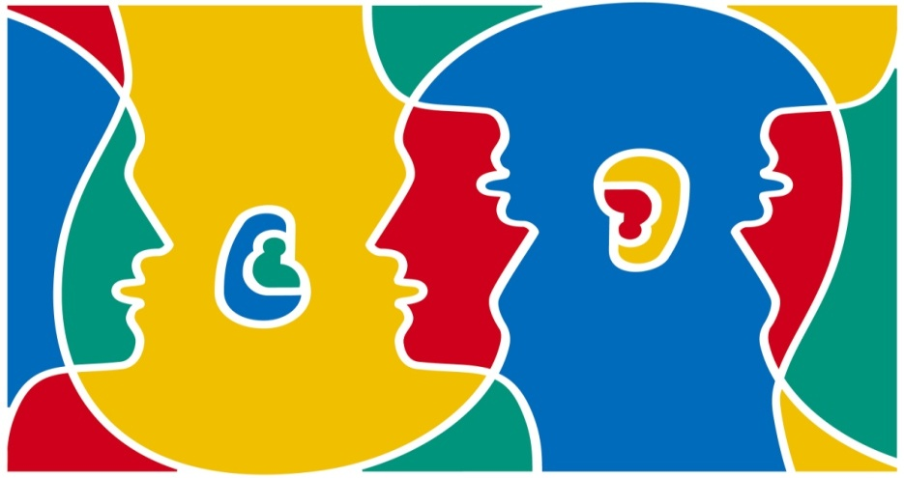
How is the language I speak related to my cultural identity?
What language/s do I speak?
What language/s does my family speak?
What language is spoken in the country that I live in?
Is it acceptable to speak other languages in America?
d.umn.edu

Slide 12
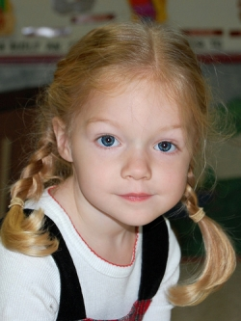
How does my physical appearance reflect my cultural identity?
How do I wear my hair?
What clothes do I choose to wear?

Slide 13
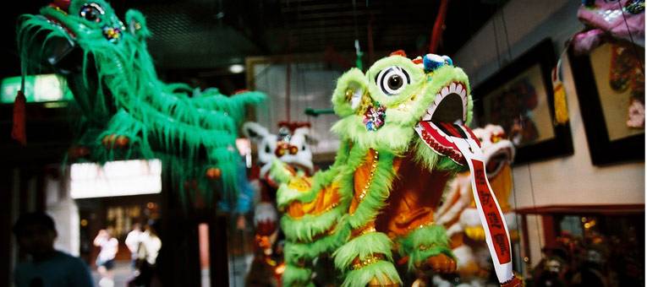
How do traditions and customs that my family shares shape my cultural identity?
What traditions and customs does my family celebrate?
How do I feel about participating in my family’s traditions and customs?
Danwei.org

Slide 14
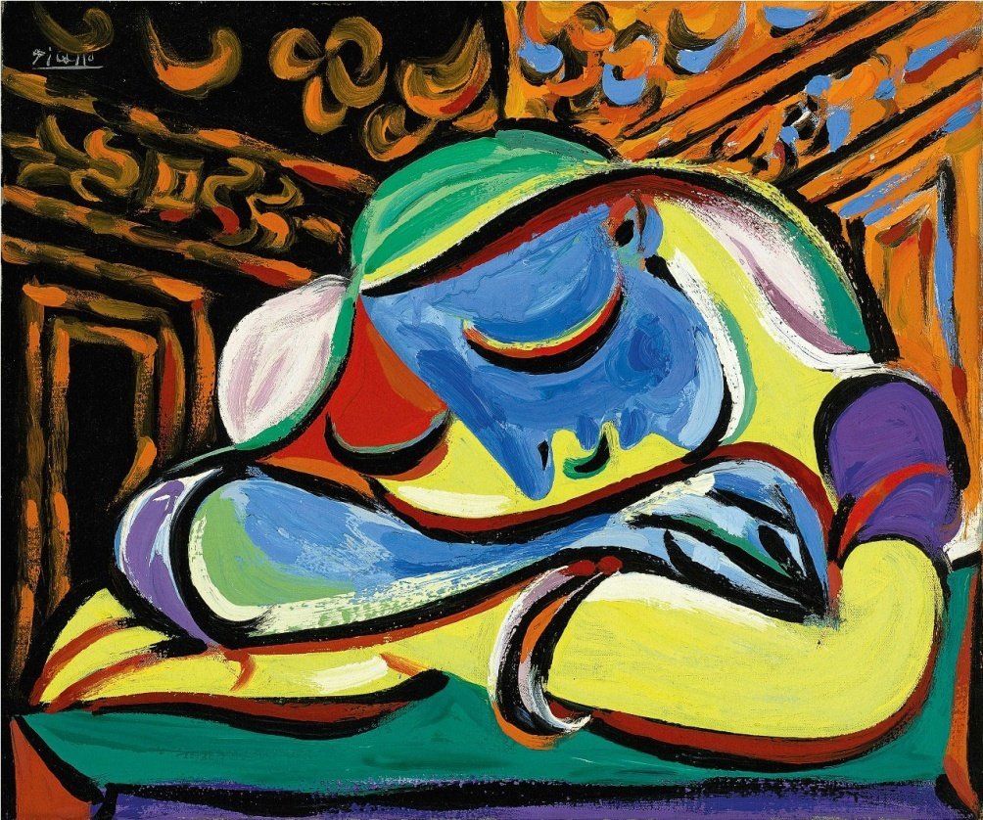
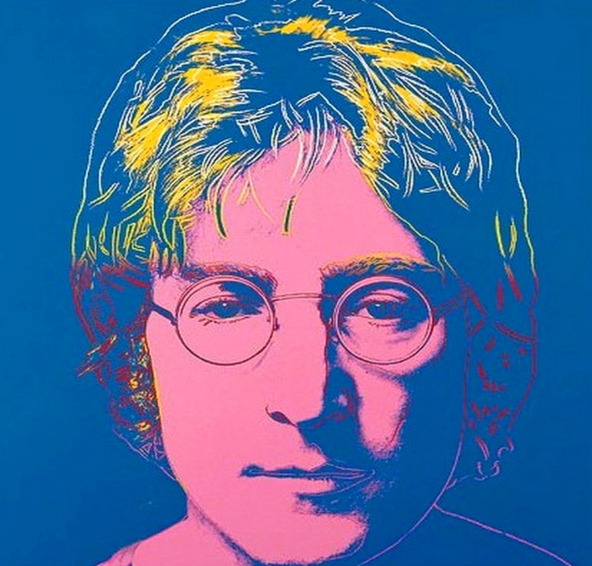
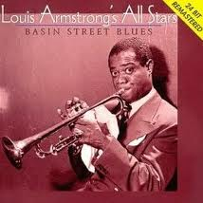
What does my art tell someone about my culture?
What art does my family share?
What painters, artists, musicians, writers do my family cherish?
Pablo Picasso
Andy Warhol

Slide 15
How does nationality shape who I am?
I live in the United States of America.
What makes me an American?

Slide 16
Who am I?

