Slide 1
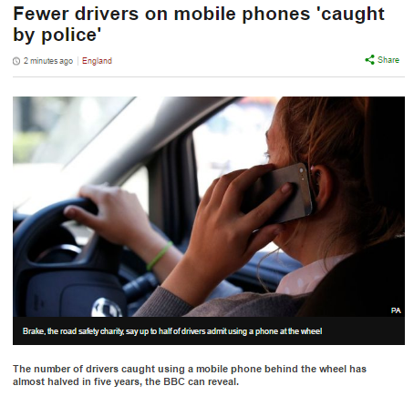

Slide 2
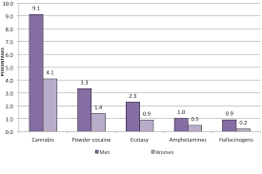
Crime and Gender
Using your own words and your notes, define this week’s key-concepts
If you are finished: using your home learning knowledge, suggest reasons why men are more likely to take drugs than women?
Social control
Chivalry thesis
Gender socialisation
explain the relationship between crime and gender.
analyse the reason for women’s increasing.involvement in crime.
Notes:
https://www.youtube.com/watch?v=Qx96VXfEpY0

Slide 3
Gender and Crime
What is gender?
Explain what sociologists mean by the term gender
(4 marks)
Recap: how do we answer this type of question?

Slide 4
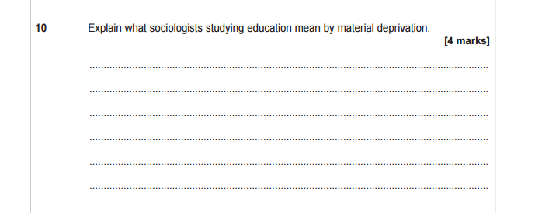

4 Mark Explain Question
Explain what sociologists mean by the term gender.
Sociologists explain gender as. . .
4 marks= a developed answer
“Explain”
Give a developed definition, making it clear how it is used in the context of education
Mark Scheme
1 | Basic statements about gender
2-3 | Partial or undeveloped explanation possibly via an example
4 | Clear explanation that shows clearly how gender is different from sex
4 min

Slide 5
Gender and Crime
Key Questions
Think of 3 examples of questions sociologists would ask in relation to crime and gender - note them down
Why have men historically committed more crime than women?
Why is crime committed by females increasing?
Are men and women treated equally by the law?
“Discuss how far sociologists would agree that females are less likely to commit crimes than men (12 marks)”

Slide 6
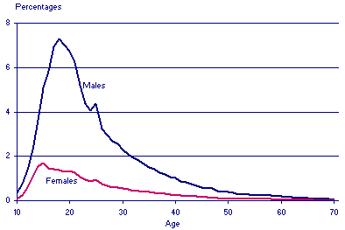
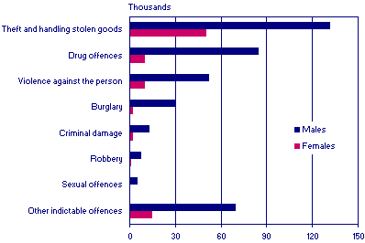
Gender and Crime
Key Trends
Analyse the graphs and then explain the trends
Where would you refer to the trends in your essay?

Slide 7
Gender and Crime
“Discuss how far sociologists would agree that females are less likely to commit crimes than men (12 marks)”
Draw in your books - take up a whole A4 page
Add information in as we complete today’s activities
For | Against

Slide 8

Gender and Crime
Why historically have men committed more crime than women?
According to the young men, what defines a ‘man’?
How might this have been the result of gender socialisation?
How do you think the young men are influenced by the absence of their fathers? Link to theory?

Slide 9
Gender and Crime
Why historically have men committed more crime than women?
Quick check questions:
When does gender socialisation occur?
How does it impact the crime rate in relation to gender?
Why do men have more opportunity to commit crime?
Challenge:
How might a psychologist and biologist explain the gender trends in crime?
Now- add the reasons to your table

Slide 10
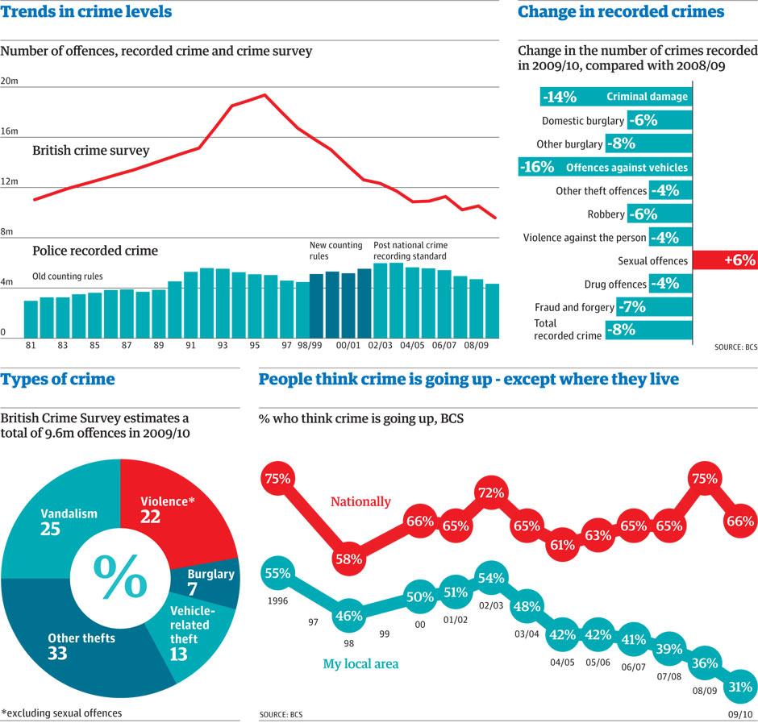
Gender and Crime
Why is crime committed by females increasing?
T-P-S
Why might women be underrepresented in crime statistics?
Crimes women commit are less likely to be reported
Women are better at concealing the evidence
Gender bias by employees of CJS - more likely to let women off and not record the crime

Slide 11




Gender and Crime
Why is crime committed by females increasing?
What does Joan Garrod (2007) say?
How would Marxists and Feminists explain an increase in crime by women?
Notes:
Women are most likely to be in low paid, unskilled, part time jobs - most exploited by capitalism
Improved position of women in society has led to changing socialisation and greater opportunities

Slide 12
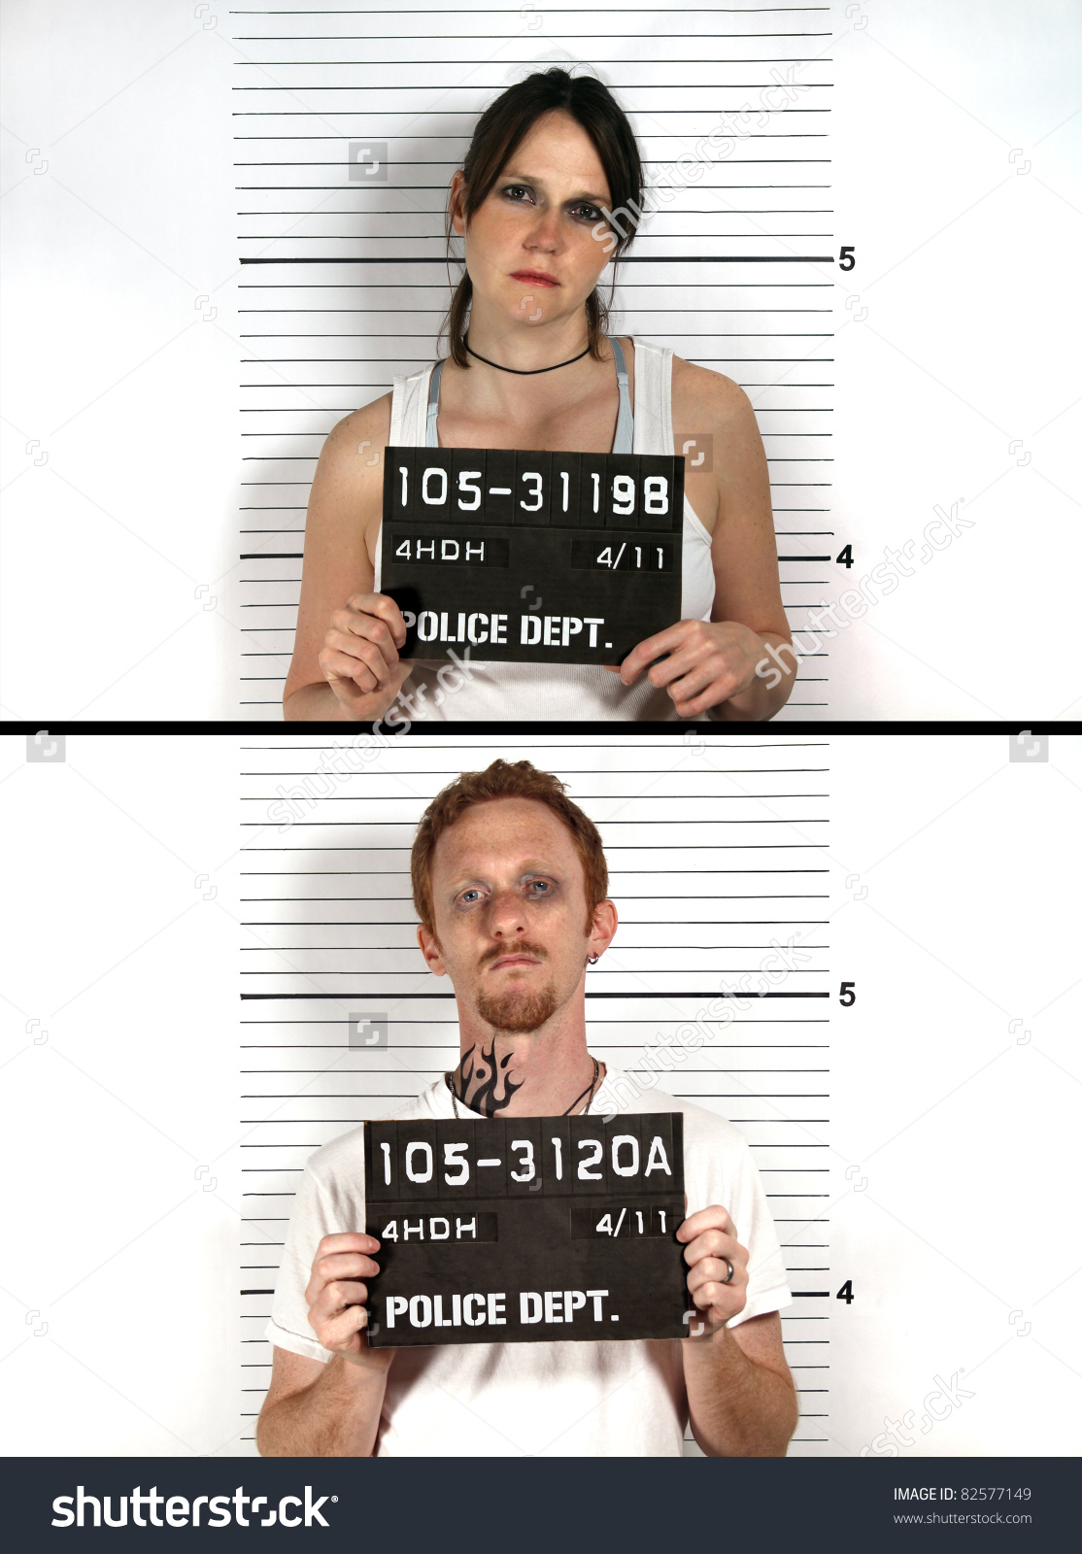


Gender and Crime
Are men and women treated equally under the law?
How has my social conditioning led to me treating men and women differently?
Summarise what the chivalry thesis is
How does this fit on to your table?

Slide 13
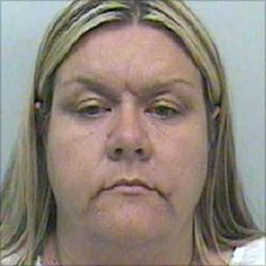
Gender and Crime
Are men and women treated equally under the law?
BUT …
When are women actually treated more harshly?
List crimes where women may be treated more harshly
Why might this be the case?
Challenge: article
Vanessa George was jailed in 2009 for sexually abusing women in the nursery where she worked
Notes:
https://www.youtube.com/watch?v=7etbBe7PH6w

Slide 14

Gender and Crime
Key Questions
Can you answer these key questions? Have a go on 3 post it notes, closed book
Why have men historically committed more crime than women?
Why is crime committed by females increasing?
Are men and women treated equally by the law?

Slide 15
Gender and Crime
Joint Essay Writing
“Discuss how far sociologists would agree that females are less likely to commit crimes than men (12 marks)”
In pairs, plan and write an essay to the above question in your purple books
Remember to use the literacy mat and planning sheet!!!

Slide 16

Gender and Crime
Plenary Hot Seat
HOT SEATING
Write down 3 questions you could ask someone on the hot seat in your book

