Slide 1
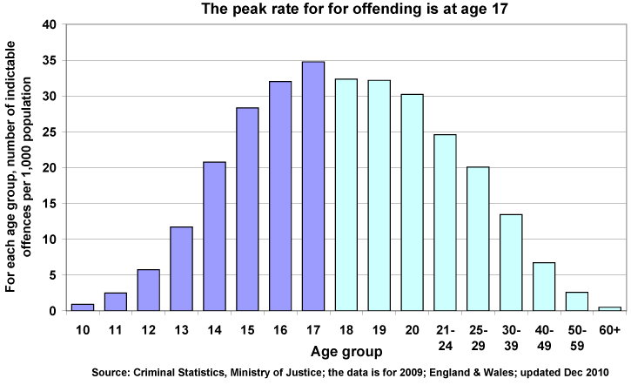
Crime and Age
List 3 possible reasons to explain the trend in the graph below
Labelling;
explain the relationship between crime and age

Slide 2
Crime and Age
Discussion
Do you know any young people who have committed crimes?
Why did they do it?
What do you think would have made them act differently?

Slide 3
Crime and Age
A hard core of disengaged youth who find it "easier to steal than work" are at the heart of a rise in repeat offending by young criminals, Victoria's top police officer says.
http://www.theage.com.au/victoria/police-chief-says-too-many-young-criminals-find-it-easier-to-steal-than-work-20160721-gqad7v.html

Slide 4
Page 22-23 Answer in full sentences – work your way through the levels!
7 - How would a Marxist or a New Right Theorist explain the amount of young people committing crime?
6 - Statistics tell us about the age of convicted or known offenders. What do they not tell us about?
5 - Using the 3 explanations given at the bottom of page 168 write a short paragraph about how sociologists may disagree over why young people commit more crime according to official statistics.
4 - According to Maguire which groups are over represented in the prison population?
3 - What do official statistics suggest about age and crime? Use data to support your answer.
2- What do findings from self-report studies suggest about age and crime?
1 - Complete the questions in the orange box on page 169
Notes:
http://www.bbc.co.uk/newsbeat/article/26544868/young-criminals-should-face-tougher-sentences

Slide 5
Young People & Crime
Whilst we watch the video, make a note of:
Evidence/examples
Statistics
Try and apply your knowledge to the clip
Labelling
explain the relationship between crime and age
Notes:
http://www.bbc.co.uk/education/clips/zd3tfg8

Slide 6
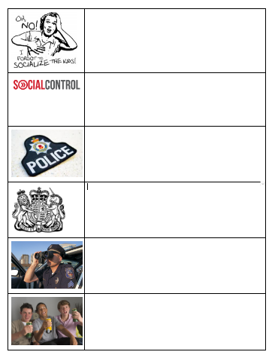
Crime and Age
Why does it appear young people commit more crime?
Complete your grids by summarising the information around the room
Challenge: write a paragraph justifying which one you think is most relevant (this will come in handy later)

Slide 7
Quick check

Slide 8
Answers

Slide 9
Crime and Age
12 Mark Question FUT
In your purple books respond to your feedback in green
Correct any SPaG
Change any ‘WC’ with a new word
Make your K&U clearer
Intro/conclusion
If you have finished, come and see me!
Notes:
June 2011

Slide 10
Crime and Age
12 Mark Question
Discuss how far sociologists would agree that the most deviant and criminal behaviour in young people results from peer group pressure [12 marks]
Notes:
June 2011

