Slide 1

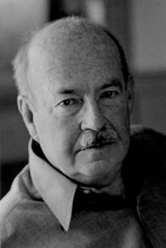

Introduction:
What type of theory are functionalists?
What type of society do they believe we live in?
Parsons:
Evaluation:
How does inequality occur?
Who gets the rewards?
Davis and Moore
Stratification and inequality have an important role in society.
Social stratification has existed in all human society and is therefore necessary
They believe:
1.
2.
3.
4.
5.
Stratification allow
How do we know which roles are most important?
Functional uniqueness
Dependence on others
Why should a CEO earn more than a cleaner?
Evaluation: Tumin
Using a different colour, annotate Davis and Moore’s study disagreeing with their perspective using Tumin.
Role allocation
2. Work to a high standard

