Slide 1
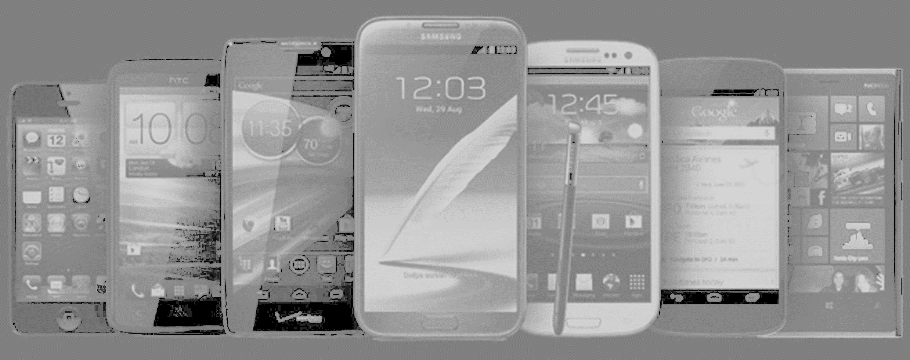

Situational Crime Prevention
Hot Products
Clarke (1999)

Slide 2

Crime is concentrated on products that are:
C
oncealable
R
emovable
A
vailable
V
aluable
E
njoyable
D
isposable
Clarke (1999)

