Slide 1
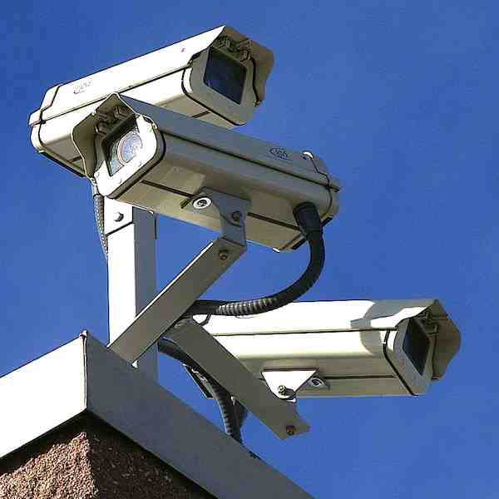
Visualising
Routine Activities Theory
Clarke and Eck (2003)

Slide 2
Routine Activities Theory
Handler
Someone, such as friends or family, with an emotional investment in controlling criminal behaviour (includes self control).
Offender
People who are positioned to take advantage of routine criminal opportunities whenever and wherever they are presented.
Manager
People, such as shopkeepers or homeowners, with direct personal investment in securing a place or target.
Place
An area within which a suitable target exists, such as a shop or home.
Handler
Manager
Offender
Place
Guardian
Those, such as police officers or security guards, with an indirect investment in securing a place or target. Guardianship may involve direct (guards) and indirect (CCTV) surveillance.
Target
A suitable, accessible, object to be stolen or person to be victimised.
Target
Guardian
Clarke and Eck (2003)
Notes:
Notes
Inner (red) triangle: Focus on motivated offender in a place they believe offers criminal opportunities and with a desirable target. If all three exist criminal behaviour is highly-likely.
Outer (yellow) triangle: The social controls surrounding potential offenders Focus on the protections that exist in places and around targets (managers, guardians) and the handlers who exert some control (including self-control) over potential offenders. Presence of any of these makes criminal behaviour less-likely.

