Slide 1
Evaluating Functionalist Perspectives
Starter: Match the command word to the description.
Analyse | Set out purposes or reasons
Define | Set out characteristics and develop purposes or reasons
Evaluate | Judge from available evidence
Explain | Separate information into components and identify their characteristics
Outline | Specify meaning
Outline and explain | Give a brief account of
Using one example, briefly explain | Set out main characteristics

Slide 2
Evaluating Functionalist Perspectives
Starter: Match the command word to the description.
Analyse | Separate information into components and identify their characteristics
Define | Specify meaning
Evaluate | Judge from available evidence
Explain | Set out purposes or reasons
Outline | Set out main characteristics
Outline and explain | Set out characteristics and develop purposes or reasons
Using one example, briefly explain | Give a brief account of

Slide 3
The functionalist family: Revision map
Briefly outline the functionalist view of the family.
Refer to Murdock and Parsons.
Study & year | Does it agree or oppose? | Key points (summarise the point, include quotes and examples). You may add in more quotes)
Laslett (1972)
Anderson (1971)
Fletcher (1998)
Cheal (2002)
Young and Wilmott (1957)

Slide 4
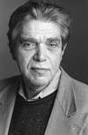
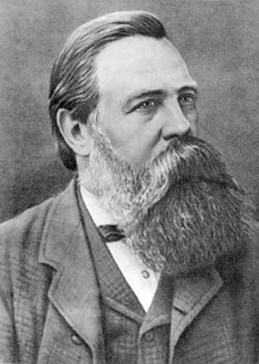
Other views on the family
Zaretsky (1976)
Read pages 234-241 (Marxist family views and Feminist family views).
Engels

Slide 5
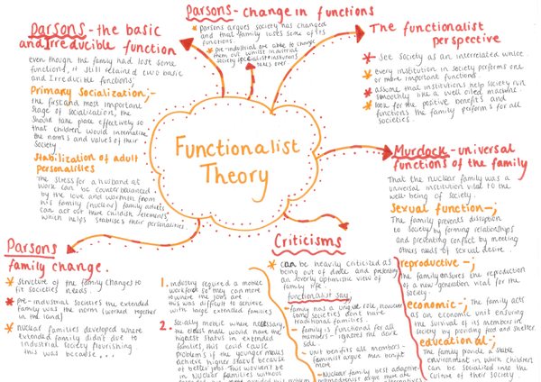

Slide 6
Exam Question
Outline and evaluate the view that the nuclear family evolved to meet the needs of a modern industrial society. (20 marks)
PEEL
Point, Evidence, Explain, Link/criticism

Slide 7
How to structure a question
INTRO
Briefly define key terms, give brief examples of points for you are going to explain in the essay and 2 brief points against
MAIN BODY
4/5 paragraphs ish!
PEEL
2 for, 2 against (or more)
CONCLUSION
Summarise your viewpoint. BE BRIEF.
DO NOT USE “I”
20 minutes!!!!!
Refer to the sociologists by name “Parsons suggests that”

Slide 8
Swap & mark

