Slide 1
A-Level Sociology
Defining
Religion
2

Slide 2
A-Level Sociology
Defining
Religion
2

Slide 3
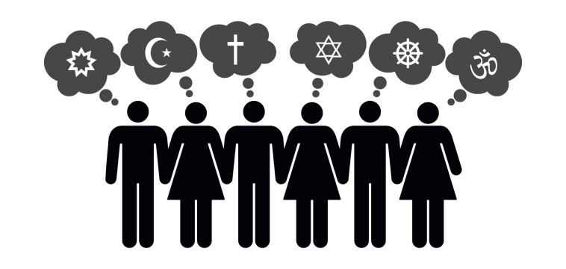
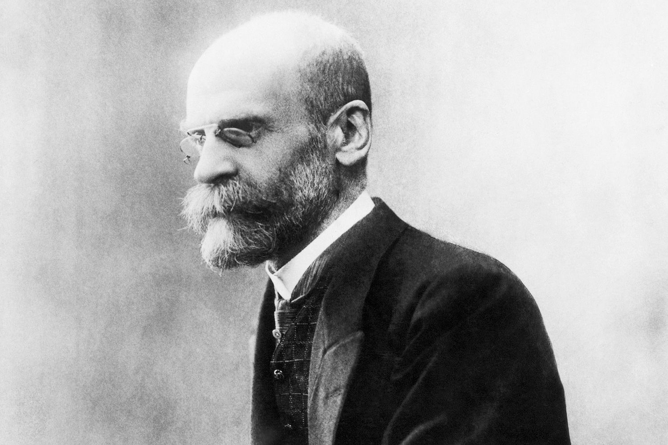
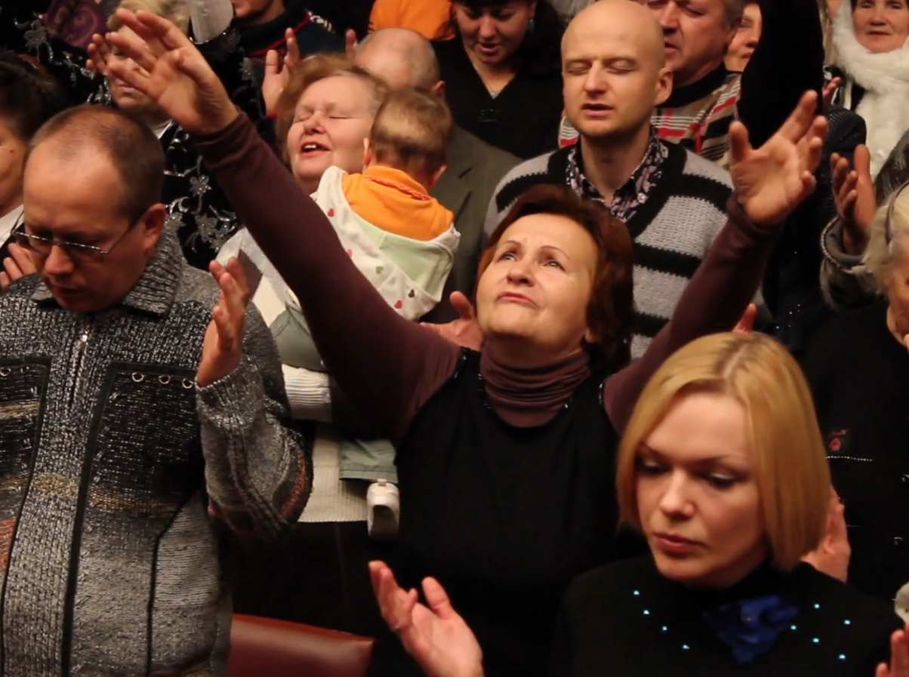
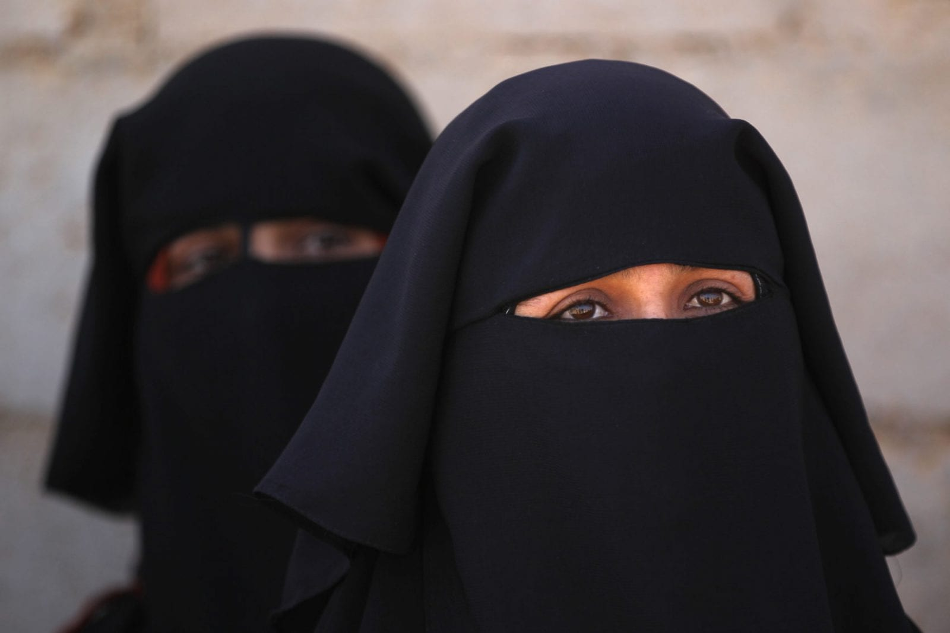
A-Level Sociology
Defining
Religion
2
ShortCutstv
inclusion…
exclusion…
exclusion…
diversity…
diversity…
inclusion…
Defining
Focus on “what religion does” for individual and society.
Focus on things conventionally seen as being religious
problems of definition exist because religion has a dual character.
Focus on things conventionally seen as being religious
Focus on “what religion does” for individual and society.
problem with this approach: religion is “everywhere and nowhere” - from football to shopping to Church attendance.
criticisms…
excludes quasi-religious behaviour that might serve a similar function to religion but which is not actually religious in the strict sense of the term.
A notable characteristic of religion is its diversity. Rather than being a single (homogeneous) entity the reality is one of wide variations across three dimensions:
shortcutstv.com
diversity
inclusion
exclusion
durkheim (1912):
social:
does religion have unique and exclusive features?
functions for society.
functions
Can’t identify those aspects of behaviour that are uniquely religious.
No way of knowing if societies are becoming:
less religious (secularisation).
more religious (resacrilisation).
belief in god or the supernatural.
behaviour such as prayer, collective worship and ceremonies.
is the definition drawn so narrowly it both excludes behaviours not conventionally seen as religious and also behaviour with some characteristics of mainstream religion but not others?
Design and Content
Chris Livesey
historical: the same society over time.
contemporary: the same society at the same time.
cross-cultural: between different societies.
social solidarity: religion creates a feeling of belonging to a particular group by providing individuals with shared beliefs and values.
personal and social identity, by specifying a moral code to follow, such as the 10 Commandments of Christianity.
socialisation into a range of moral beliefs and values.
social solidarity: a sense we have things in common.
social control: both direct - Islamic codes define what people may wear or eat, for example - and indirect (such as teaching moral codes of behaviour).
Scientology makes no distinction between "the sacred" and the "profane" but does it focus on ideas about spirituality that are religious in nature?

Slide 4
diversity…
Defining
problems of definition exist because religion has a dual character.
A notable characteristic of religion is its diversity. Rather than being a single (homogeneous) entity the reality is one of wide variations across three dimensions:
diversity
inclusion
exclusion
individual:
a variety of ways to be religious.
historical: the same society over time.
contemporary: the same society at the same time.
cross-cultural: between different societies.
Some involve communal practices, such as attending religious ceremonies, others simply involve following individual practices.
It’s possible, for example, to be “a Christian" without ever setting foot inside a church.
Notes:
Navigation
To move around the Presentation you have two options:
1. Move the mouse pointer to the edge of the screen and the Presentation will move forwards or backwords one slide.
2. Use the Menu points at the bottom of the screen to move back / forward one slide from the highlighted page.
To return to the mani menu at the end of each section press the green button at the bottom right of the page.
The session can be ended from the main menu by clicking the red button at the bottom left of the page.

Slide 5
diversity…
problems of definition exist because religion has a dual character.
problems of definition exist because religion has a dual character.
A notable characteristic of religion is its diversity. Rather than being a single (homogeneous) entity the reality is one of wide variations across three dimensions:
individual:
social:
a variety of ways to be religious.
functions for society.
historical: the same society over time.
contemporary: the same society at the same time.
cross-cultural: between different societies.
Some involve communal practices, such as attending religious ceremonies, others simply involve following individual practices.
It’s possible, for example, to be “a Christian" without ever setting foot inside a church.
socialisation into a range of moral beliefs and values.
social solidarity: a sense we have things in common.
social control: both direct - Islamic codes define what people may wear or eat, for example - and indirect (such as teaching moral codes of behaviour).

Slide 6
diversity…
Defining
problems of definition exist because religion has a dual character.
diversity
inclusion
exclusion
individual:
social:
a variety of ways to be religious.
functions for society.
Some involve communal practices, such as attending religious ceremonies, others simply involve following individual practices.
It’s possible, for example, to be “a Christian" without ever setting foot inside a church.
socialisation into a range of moral beliefs and values.
social solidarity: a sense we have things in common.
social control: both direct - Islamic codes define what people may wear or eat, for example - and indirect (such as teaching moral codes of behaviour).

Slide 7
inclusion…
Defining
Focus on “what religion does” for individual and society.
diversity
inclusion
exclusion
durkheim (1912):
functions
social solidarity: religion creates a feeling of belonging to a particular group by providing individuals with shared beliefs and values.
personal and social identity, by specifying a moral code to follow, such as the 10 Commandments of Christianity.
personal and social identity: significant source of identity for those who follow the teachings of a particular religion.
Religions may specify ethical and moral values through which to lead your life.

Slide 8
inclusion…
Focus on “what religion does” for individual and society.
durkheim (1912):
durkheim (1912):
functions
functions
social solidarity: religion creates a feeling of belonging to a particular group by providing individuals with shared beliefs and values.
personal and social identity, by specifying a moral code to follow, such as the 10 Commandments of Christianity.
personal and social identity: significant source of identity for those who follow the teachings of a particular religion.
Religions may specify ethical and moral values through which to lead your life.
social integration: the specific ways social solidarity is created, through mechanisms like shared practices and experiences - things like religious services and ceremonies.

Slide 9
inclusion…
Focus on “what religion does” for individual and society.
Focus on “what religion does” for individual and society.
cline (2005):
durkheim (1912):
content of religious beliefs not important.
functions
"If your belief system plays some particular role either in your social life, in your society, or in your psychological life, then it is a religion; otherwise, it’s something else".
social integration: the specific ways social solidarity is created, through mechanisms like shared practices and experiences - things like religious services and ceremonies.
personal and social identity: significant source of identity for those who follow the teachings of a particular religion.
Religions may specify ethical and moral values through which to lead your life.

Slide 10
inclusion…
Focus on “what religion does” for individual and society.
cline (2005):
religion is a belief system (ideology), based on faith.
The unconditional belief in a particular set of ideas.
durkheim (1912):
content of religious beliefs not important.
functions
"If your belief system plays some particular role either in your social life, in your society, or in your psychological life, then it is a religion; otherwise, it’s something else".
Any faith-based behaviour is seen as religious:
conventional forms, like a belief in "god“.
unconventional forms such as political ideologies like MAGA Trumpism.
social integration: the specific ways social solidarity is created, through mechanisms like shared practices and experiences - things like religious services and ceremonies.

Slide 11
inclusion…
Focus on “what religion does” for individual and society.
cline (2005):
definitions develop out of how people define their own behaviour. Religion and religious behaviour are whatever people claim them to be.
religion is a belief system (ideology), based on faith.
The unconditional belief in a particular set of ideas.
content of religious beliefs not important.
"If your belief system plays some particular role either in your social life, in your society, or in your psychological life, then it is a religion; otherwise, it’s something else".
Any faith-based behaviour is seen as religious:
conventional forms, like a belief in "god“.
unconventional forms such as political ideologies like MAGA Trumpism.
overcomes problem of devising over-arching definition of religious behaviour.
not necessary to account for every tiny variation in beliefs and behaviours to develop a workable definition of religion.

Slide 12
inclusion…
Focus on “what religion does” for individual and society.
definitions develop out of how people define their own behaviour. Religion and religious behaviour are whatever people claim them to be.
problem with this approach: religion is “everywhere and nowhere” - from football to shopping to Church attendance.
religion is a belief system (ideology), based on faith.
The unconditional belief in a particular set of ideas.
Any faith-based behaviour is seen as religious:
conventional forms, like a belief in "god“.
unconventional forms such as political ideologies like MAGA Trumpism.
overcomes problem of devising over-arching definition of religious behaviour.
not necessary to account for every tiny variation in beliefs and behaviours to develop a workable definition of religion.
Can’t identify those aspects of behaviour that are uniquely religious.
No way of knowing if societies are becoming:
less religious (secularisation).
more religious (resacrilisation).

Slide 13
inclusion…
Defining
Focus on “what religion does” for individual and society.
problem with this approach: religion is “everywhere and nowhere” - from football to shopping to Church attendance.
definitions develop out of how people define their own behaviour. Religion and religious behaviour are whatever people claim them to be.
diversity
inclusion
exclusion
Can’t identify those aspects of behaviour that are uniquely religious.
No way of knowing if societies are becoming:
less religious (secularisation).
more religious (resacrilisation).
overcomes problem of devising over-arching definition of religious behaviour.
not necessary to account for every tiny variation in beliefs and behaviours to develop a workable definition of religion.

Slide 14
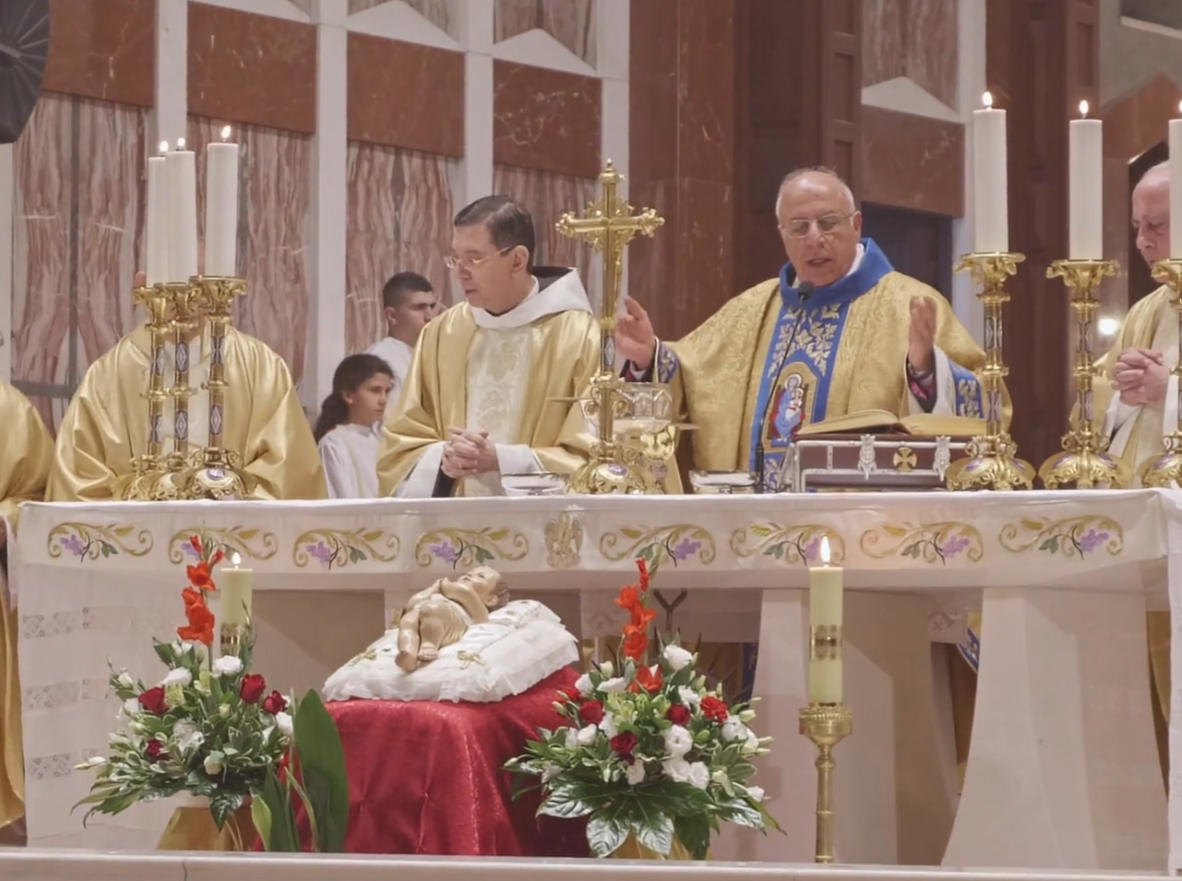
exclusion…
Defining
Focus on things conventionally seen as being religious
excludes quasi-religious behaviour that might serve a similar function to religion but which is not actually religious in the strict sense of the term.
religion not defined by faith alone: religious beliefs are qualitatively different to other forms of belief.
diversity
inclusion
exclusion
belief in god or the supernatural.
behaviour such as prayer, collective worship and ceremonies.
substantive definition of religion focused on its content or substance: the beliefs, practices and organisations that are distinctively religious and which mark religious behaviour as qualitatively different to other, similar, behaviours.

Slide 15
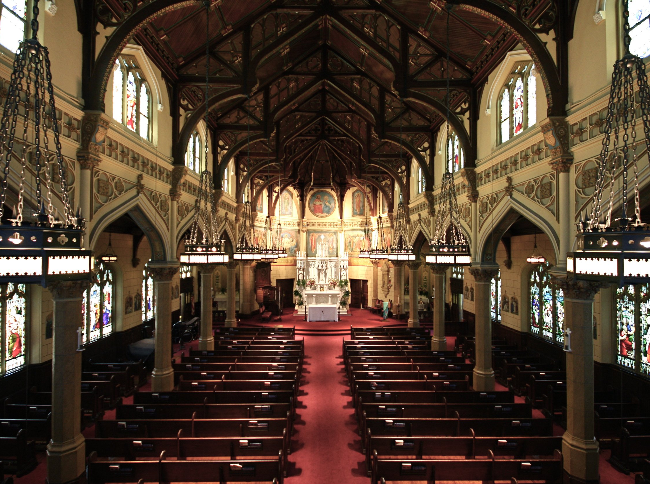
exclusion…
Focus on things conventionally seen as being religious
religion not defined by faith alone: religious beliefs are qualitatively different to other forms of belief.
excludes quasi-religious behaviour that might serve a similar function to religion but which is not actually religious in the strict sense of the term.
beckford (1980)
substantive definition of religion focused on its content or substance: the beliefs, practices and organisations that are distinctively religious and which mark religious behaviour as qualitatively different to other, similar, behaviours.
“exclusive approaches restrict the term 'religion' to phenomena displaying definite properties which do not occur together in other phenomena"
belief in god or the supernatural.
behaviour such as prayer, collective worship and ceremonies.

Slide 16
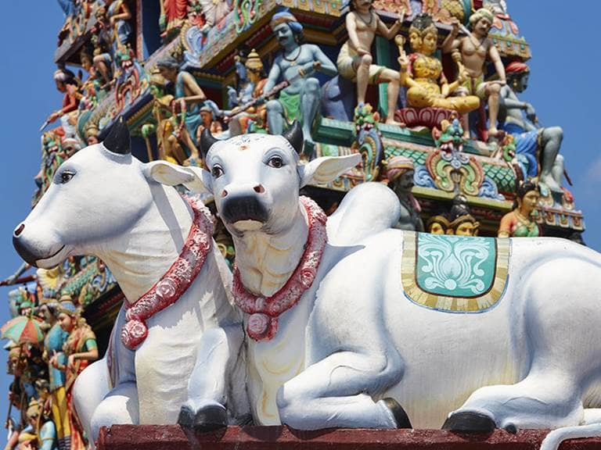
exclusion…
Focus on things conventionally seen as being religious
essentialism:
religion not defined by faith alone: religious beliefs are qualitatively different to other forms of belief.
beckford (1980)
religions have unique characteristics that mark them apart from the everyday:
substantive definition of religion focused on its content or substance: the beliefs, practices and organisations that are distinctively religious and which mark religious behaviour as qualitatively different to other, similar, behaviours.
“exclusive approaches restrict the term 'religion' to phenomena displaying definite properties which do not occur together in other phenomena"
• the sacred: "that which is utterly and mysteriously precious in our experience" (Maguire, 2001)

Slide 17
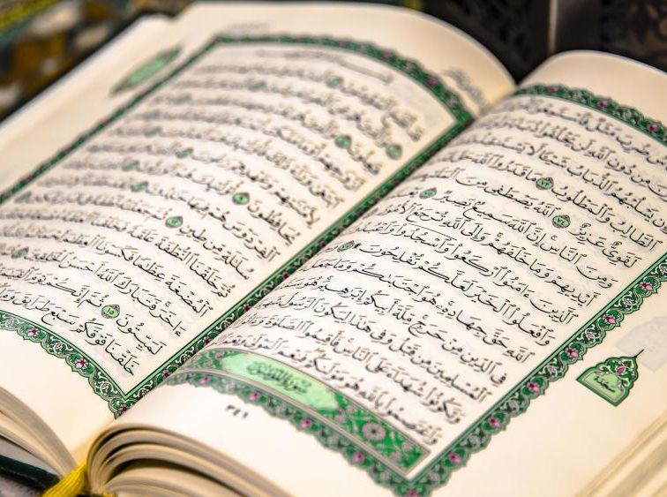
exclusion…
Focus on things conventionally seen as being religious
essentialism:
beckford (1980)
religions have unique characteristics that mark them apart from the everyday:
“exclusive approaches restrict the term 'religion' to phenomena displaying definite properties which do not occur together in other phenomena"
• the sacred: "that which is utterly and mysteriously precious in our experience" (Maguire, 2001)
moral codes with a sacred origin,
examples include the 10 Commandments given to Moses by God in Christian religions and Sharia in Islam.
communication with the supernatural, through mechanisms such as prayer.

Slide 18
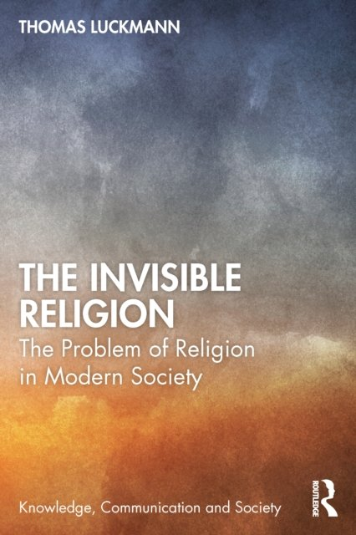
exclusion…
Focus on things conventionally seen as being religious
essentialism:
luckmann (1967):
religions have unique characteristics that mark them apart from the everyday:
religion is a unique belief system because it:
• the sacred: "that which is utterly and mysteriously precious in our experience" (Maguire, 2001)
moral codes with a sacred origin,
Explains the individual's place in the world.
Provides a sense of moral and political order.
Explains "why we are here" and what happens after death.
examples include the 10 Commandments given to Moses by God in Christian religions and Sharia in Islam.
communication with the supernatural, through mechanisms such as prayer.

Slide 19
exclusion…
Focus on things conventionally seen as being religious
essentialism:
luckmann (1967):
exclusive approaches key into what we conventionally understand about religion: behaviour that is special and different.
religions have unique characteristics that mark them apart from the everyday:
religion is a unique belief system because it:
moral codes with a sacred origin,
Explains the individual's place in the world.
Provides a sense of moral and political order.
Explains "why we are here" and what happens after death.
substantive definitions make it possible to measure levels of religious behaviour.
To test, for example, whether society is becoming secularised or resacrilised.
examples include the 10 Commandments given to Moses by God in Christian religions and Sharia in Islam.
communication with the supernatural, through mechanisms such as prayer.

Slide 20
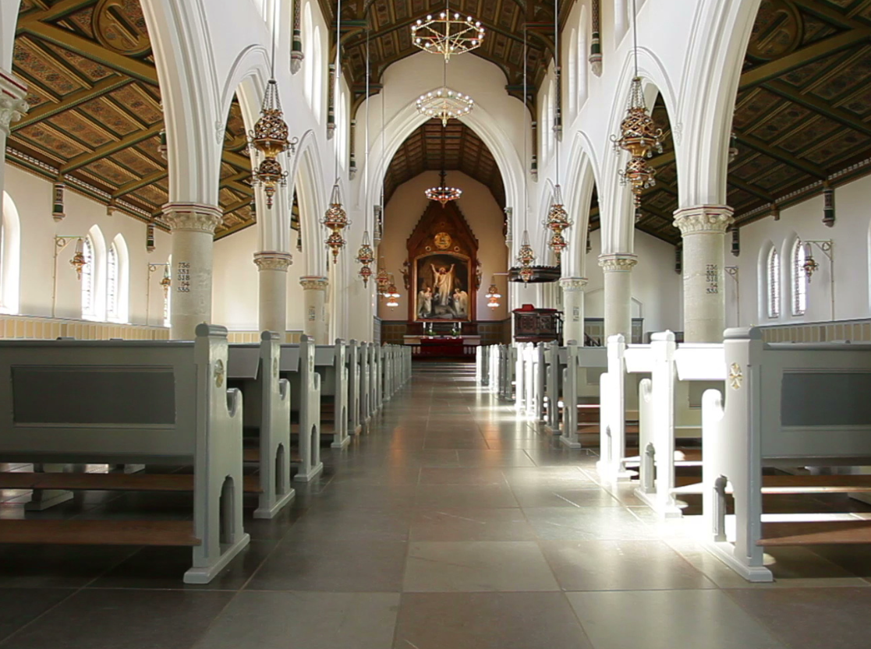
exclusion…
Focus on things conventionally seen as being religious
luckmann (1967):
exclusive approaches key into what we conventionally understand about religion: behaviour that is special and different.
criticisms…
does religion have unique and exclusive features?
religion is a unique belief system because it:
substantive definitions make it possible to measure levels of religious behaviour.
To test, for example, whether society is becoming secularised or resacrilised.
do exclusive approaches simply adopt a definition that fits neatly with conventional, mainstream, world religions such as Christianity or Islam:
Explains the individual's place in the world.
Provides a sense of moral and political order.
Explains "why we are here" and what happens after death.
is religion defined as whatever these institutions say it is?

Slide 21
exclusion…
Focus on things conventionally seen as being religious
criticisms…
exclusive approaches key into what we conventionally understand about religion: behaviour that is special and different.
does religion have unique and exclusive features?
do exclusive approaches simply adopt a definition that fits neatly with conventional, mainstream, world religions such as Christianity or Islam:
substantive definitions make it possible to measure levels of religious behaviour.
To test, for example, whether society is becoming secularised or resacrilised.
do major religions like Christianity have a vested interest in ensuring the product they are "selling" (religious experience) is both unique and has limited competition?
is religion defined as whatever these institutions say it is?

Slide 22
exclusion…
Focus on things conventionally seen as being religious
criticisms…
does religion have unique and exclusive features?
do exclusive approaches simply adopt a definition that fits neatly with conventional, mainstream, world religions such as Christianity or Islam:
do major religions like Christianity have a vested interest in ensuring the product they are "selling" (religious experience) is both unique and has limited competition?
is the definition drawn so narrowly it both excludes behaviours not conventionally seen as religious and also behaviour with some characteristics of mainstream religion but not others?
is religion defined as whatever these institutions say it is?
Scientology makes no distinction between "the sacred" and the "profane" but does it focus on ideas about spirituality that are religious in nature?

Slide 23
exclusion…
Defining
Focus on things conventionally seen as being religious
criticisms…
diversity
inclusion
exclusion
does religion have unique and exclusive features?
is the definition drawn so narrowly it both excludes behaviours not conventionally seen as religious and also behaviour with some characteristics of mainstream religion but not others?
do major religions like Christianity have a vested interest in ensuring the product they are "selling" (religious experience) is both unique and has limited competition?
Scientology makes no distinction between "the sacred" and the "profane" but does it focus on ideas about spirituality that are religious in nature?

Slide 24
ShortCutstv
Defining
shortcutstv.com
diversity
inclusion
exclusion
Design and Content
Chris Livesey

