Slide 1

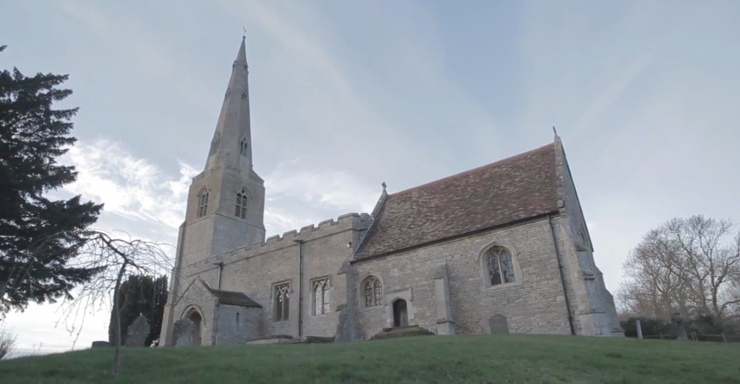
A-Level Sociology
Defining
Religion

Slide 2
Defining
A-Level Sociology
Defining
Religion

Slide 3
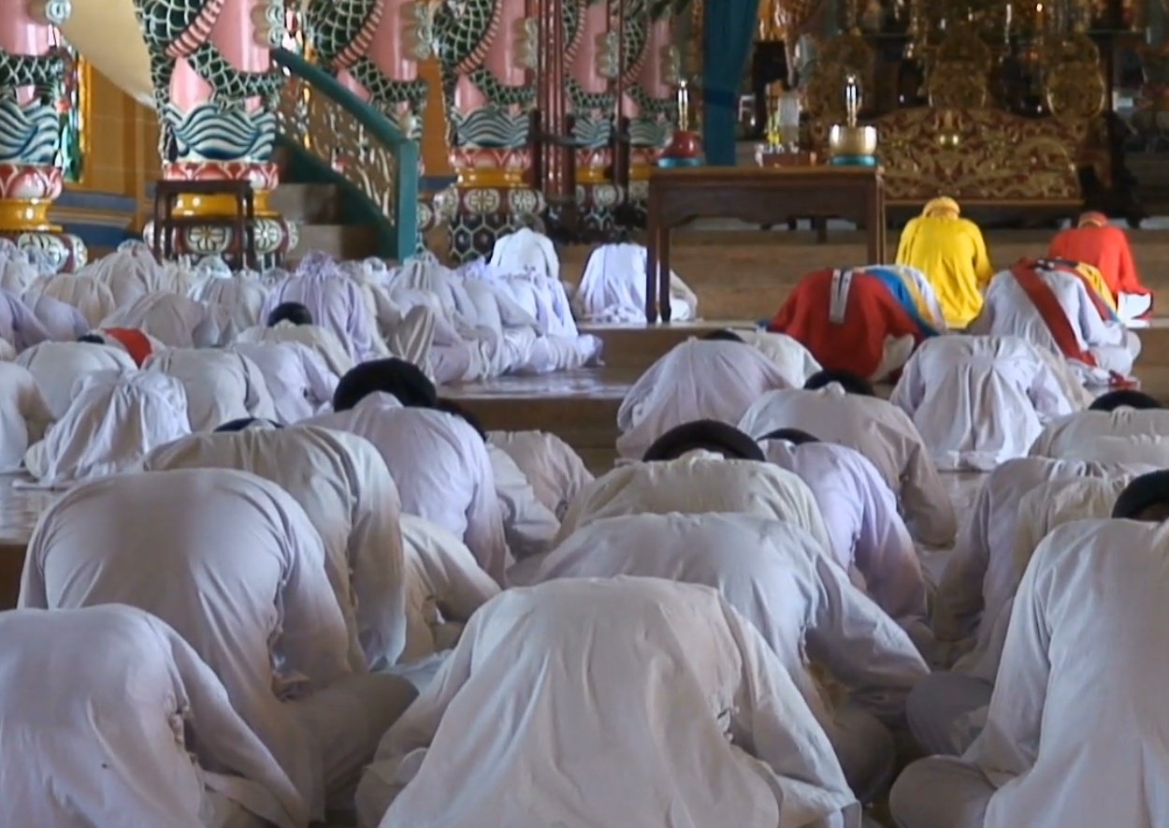


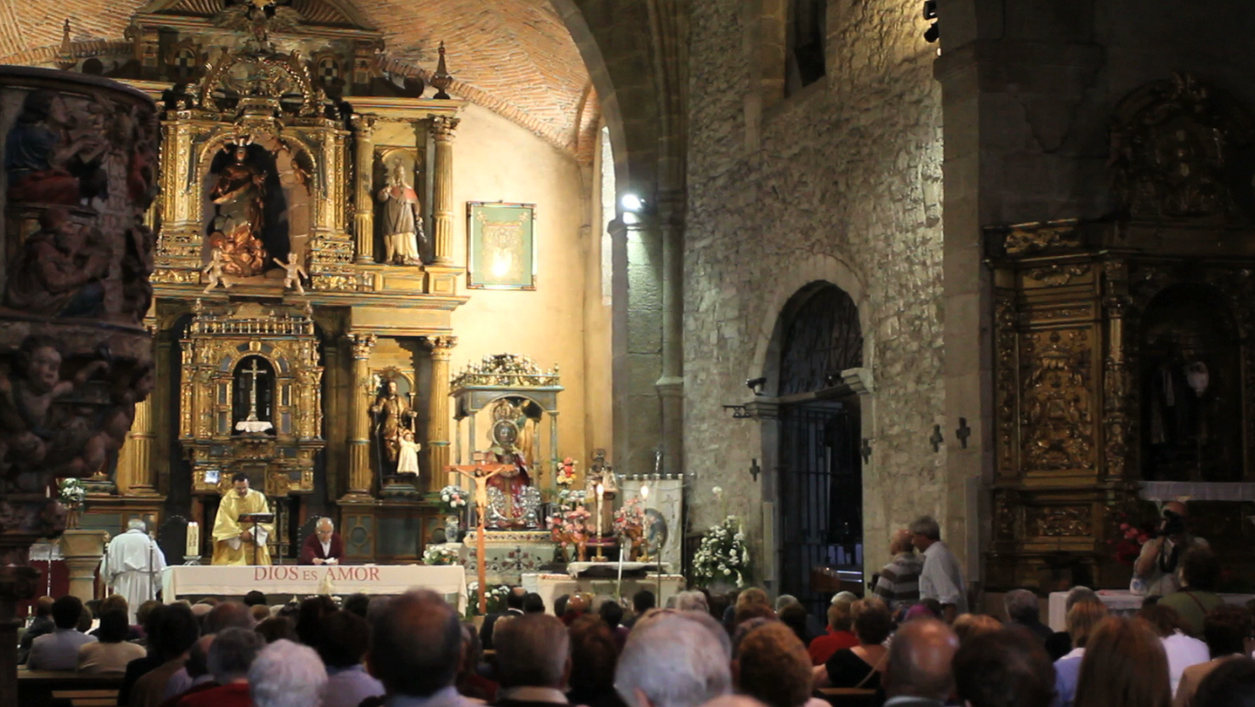
A-Level Sociology
Defining
Religion
Practices…
Beliefs…
ShortCutstv
Organization…
Defining
Religion involves a set of practices, involving things like collective worship and prayer, that can be expanded to include ceremonies, such as weddings, funerals and religious festivals.
Religion involves a set of beliefs that includes a notion of "God" or some kind of "supernatural force or being" that exists over-and-above the human population.
Some form of structure that allows practices and beliefs to be collectively expressed. This includes:
shortcutstv.com
beliefs
practices
organization
Design and Content
Chris Livesey
sacred places
such as a Church, Mosque or Meeting Hall.
sacred people
such as vicars, priests and Imams, employed by a religious organisation to take services or generally look-after believers' well-being.
Monotheistic
A belief in single God, Examples include: Christianity, Judaism and Islam.
Polytheistic
A belief in many gods. Examples include Hinduism and Paganism
Non-theistic
No worship of "gods".
The North American Sioux understood the world in terms of Waken Beings or Powers; the expression of anything "incomprehensible".

Slide 4
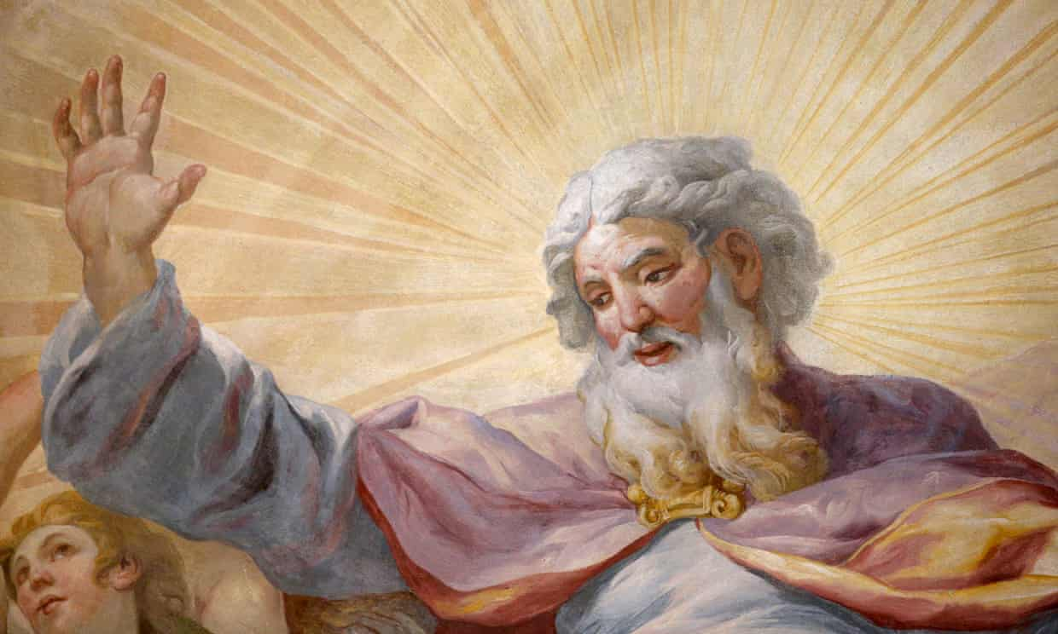
Beliefs…
Defining
Religion involves a set of beliefs that includes a notion of "God" or some kind of "supernatural force or being" that exists over-and-above the human population.
These can be many and varied:
beliefs
practices
organization
Monotheistic
A belief in single God, Examples include: Christianity, Judaism and Islam.
Polytheistic
A belief in many gods. Examples include Hinduism and Paganism
Non-theistic
No worship of "gods".
The North American Sioux understood the world in terms of Waken Beings or Powers; the expression of anything "incomprehensible".

Slide 5

Beliefs…
Defining
Religion involves a set of beliefs that includes a notion of "God" or some kind of "supernatural force or being" that exists over-and-above the human population.
A set of beliefs that includes a notion of "God" or at least some kind of "supernatural force or being" that exists over-and-above human beings.
These can be many and varied:
There are also differences in how "god” is theorised:
beliefs
practices
organization
Monotheistic
A belief in single God, Examples include: Christianity, Judaism and Islam.
Polytheistic
A belief in many gods. Examples include Hinduism and Paganism
Non-theistic
No worship of "gods".
The North American Sioux understood the world in terms of Waken Beings or Powers; the expression of anything "incomprehensible".
External to the individual
Examples include:
Christianity, Hinduism
and Islam.
Internal to the individual
The aim of some religions, such as Scientology, is to reveal a person's "inner spirituality or godliness".

Slide 6
Beliefs…
Defining
These can be many and varied:
There are also differences in how "god” is theorised:
beliefs
practices
organization
Monotheistic
A belief in single God, Examples include: Christianity, Judaism and Islam.
Polytheistic
A belief in many gods. Examples include Hinduism and Paganism
Non-theistic
No worship of "gods".
The North American Sioux understood the world in terms of Waken Beings or Powers; the expression of anything "incomprehensible".
External to the individual
Examples include:
Christianity, Hinduism
and Islam.
Internal to the individual
The aim of some religions, such as Scientology, is to reveal a person's "inner spirituality or godliness".

Slide 7
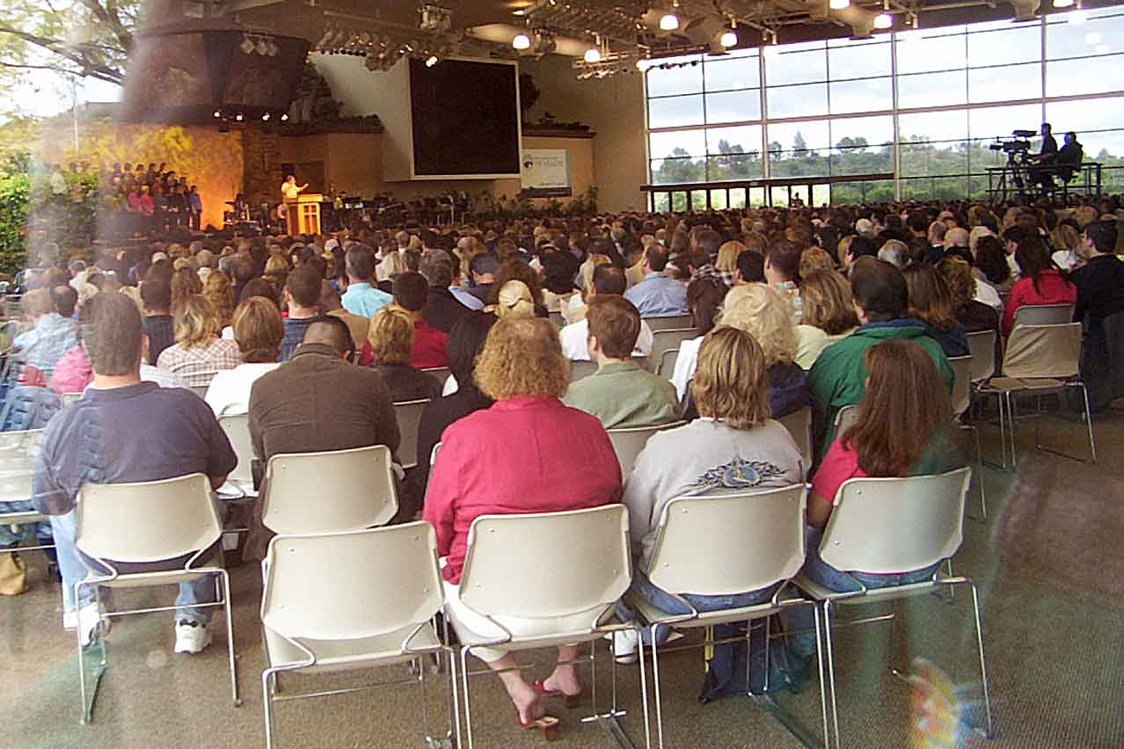
Practices…
Defining
Religion involves a set of practices, involving things like collective worship and prayer, that can be expanded to include ceremonies, such as weddings, funerals and religious festivals.
Examples of religious practice:
beliefs
practices
organization
personal communication with God through prayer: (Christianity)
communal worship: (Christianity and Islam)
baptism for the dead:
(The Church of Jesus Christ of Latter-day Saints - "Mormons")). Those who have died can be baptised by proxy; they are considered Mormons after death, even though they were not in life
exorcism:
"evil spiritual entities" are evicted from a person or place they "possess“ (Roman Catholicism and Eastern Orthodox Churches)

Slide 8
Practices…
Religion involves a set of practices, involving things like collective worship and prayer, that can be expanded to include ceremonies, such as weddings, funerals and religious festivals.
Examples of religious practice:
personal communication with God through prayer: (Christianity)
communal worship: (Christianity and Islam)
baptism for the dead:
(The Church of Jesus Christ of Latter-day Saints - "Mormons")). Those who have died can be baptised by proxy; they are considered Mormons after death, even though they were not in life
exorcism:
"evil spiritual entities" are evicted from a person or place they "possess“ (Roman Catholicism and Eastern Orthodox Churches)

Slide 9
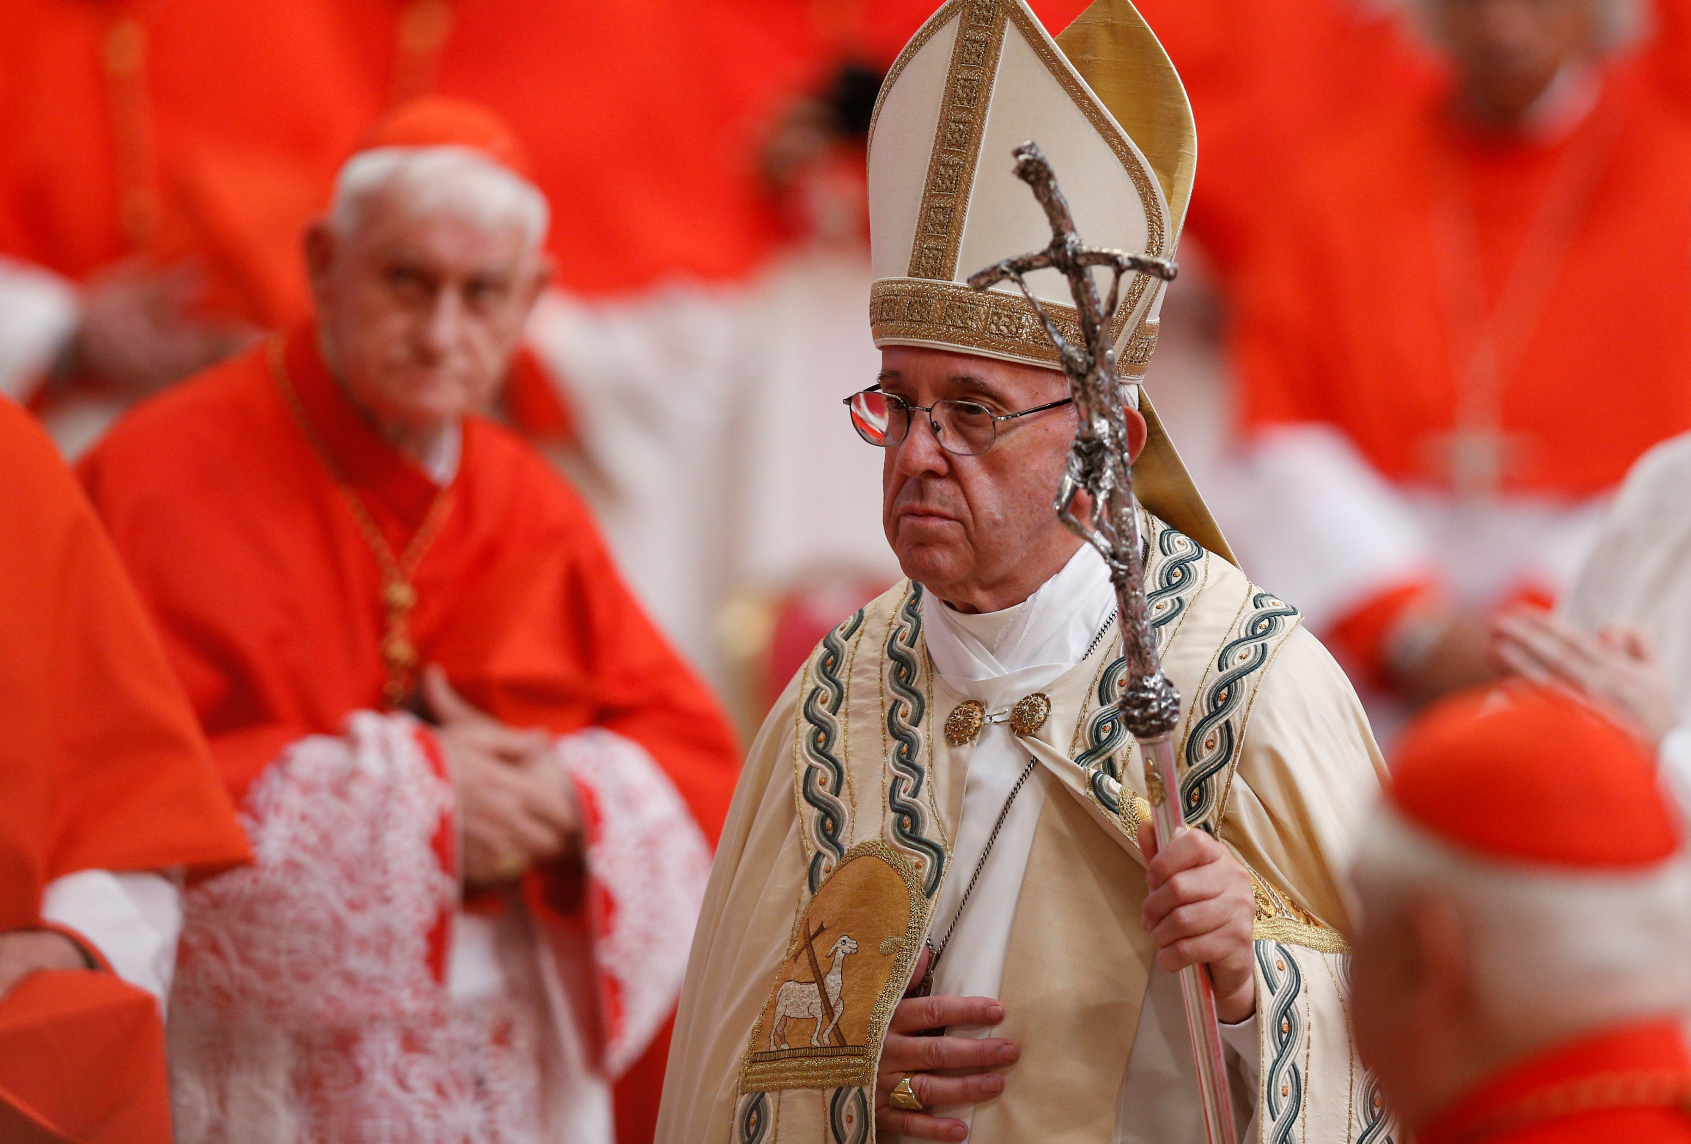
Organization…
Defining
Some form of structure that allows practices and beliefs to be collectively expressed. This includes:
Different levels:
beliefs
practices
organization
sacred places
such as a Church, Mosque or Meeting Hall.
sacred people
such as vicars, priests and Imams, employed by a religious organisation to take services or generally look-after believers' well-being.
Tightly organized
Catholicism has a highly developed structure with paid employees at various levels in a corporate hierarchy, with the Pope at its head supported by Cardinals. It also has a strict doctrine; a set of beliefs and principles to which the practitioner must conform: contraception, for example, is forbidden.

Slide 10
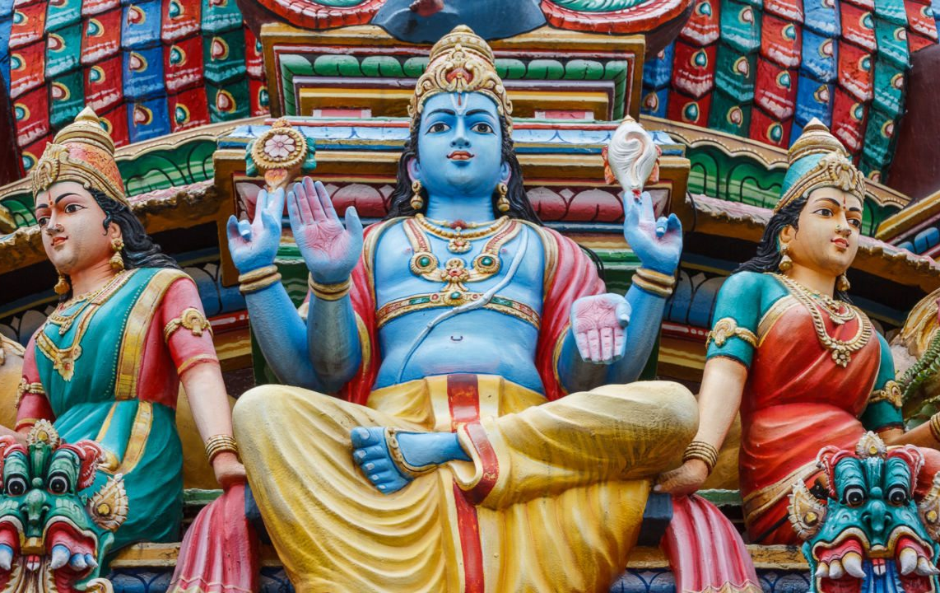
Organization…
Defining
Different levels:
Some form of structure that allows practices and beliefs to be collectively expressed. This includes:
beliefs
practices
organization
Tightly organized
Catholicism has a highly developed structure with paid employees at various levels in a corporate hierarchy, with the Pope at its head supported by Cardinals. It also has a strict doctrine; a set of beliefs and principles to which the practitioner must conform: contraception, for example, is forbidden.
Loosely organised
Hinduism is a religious belief system involving a multitude of groups, some connected and some not, built around the central idea of a "universal soul“. It doesn’t recognise a single set of beliefs or practices as being "uniquely Hindu".
sacred places
such as a Church, Mosque or Meeting Hall.
sacred people
such as vicars, priests and Imams, employed by a religious organisation to take services or generally look-after believers' well-being.

Slide 11
Organization…
Defining
Different levels:
beliefs
practices
organization
Loosely organised
Hinduism is a religious belief system involving a multitude of groups, some connected and some not, built around the central idea of a "universal soul“. It doesn’t recognise a single set of beliefs or practices as being "uniquely Hindu".
Tightly organized
Catholicism has a highly developed structure with paid employees at various levels in a corporate hierarchy, with the Pope at its head supported by Cardinals. It also has a strict doctrine; a set of beliefs and principles to which the practitioner must conform: contraception, for example, is forbidden.

Slide 12
A-Level Sociology
Defining
Religion
ShortCutstv
Defining
shortcutstv.com
beliefs
practices
organization
Design and Content
Chris Livesey
Monotheistic
A belief in single God, Examples include: Christianity, Judaism and Islam.
Polytheistic
A belief in many gods. Examples include Hinduism and Paganism
Non-theistic
No worship of "gods".
The North American Sioux understood the world in terms of Waken Beings or Powers; the expression of anything "incomprehensible".

