Slide 1
shortcutstv
presents

Slide 2
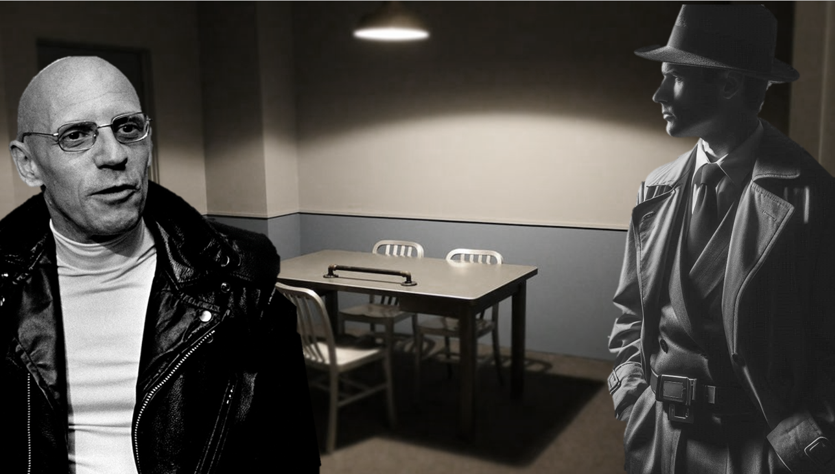

Slide 3
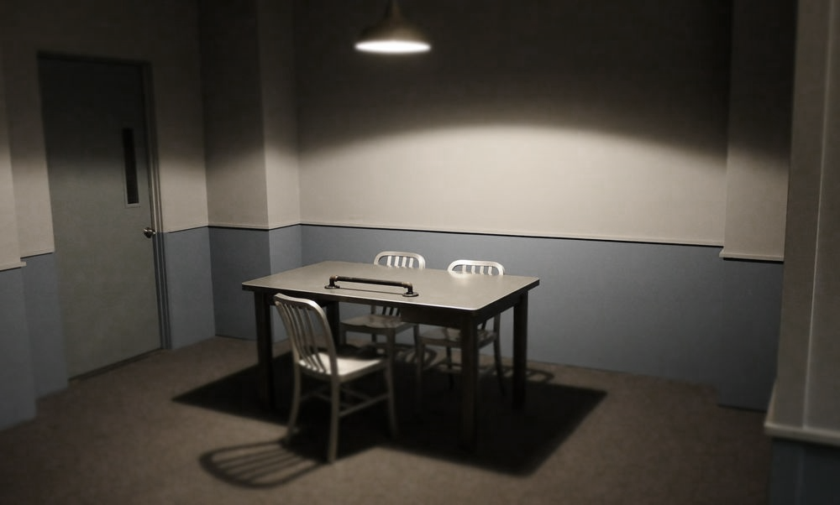
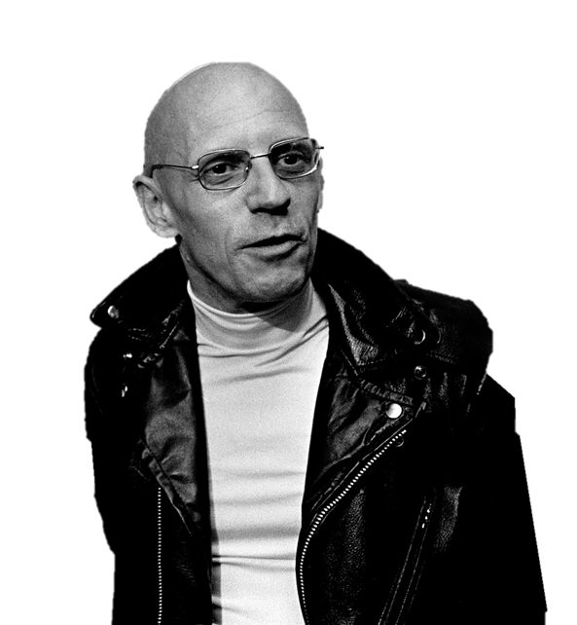
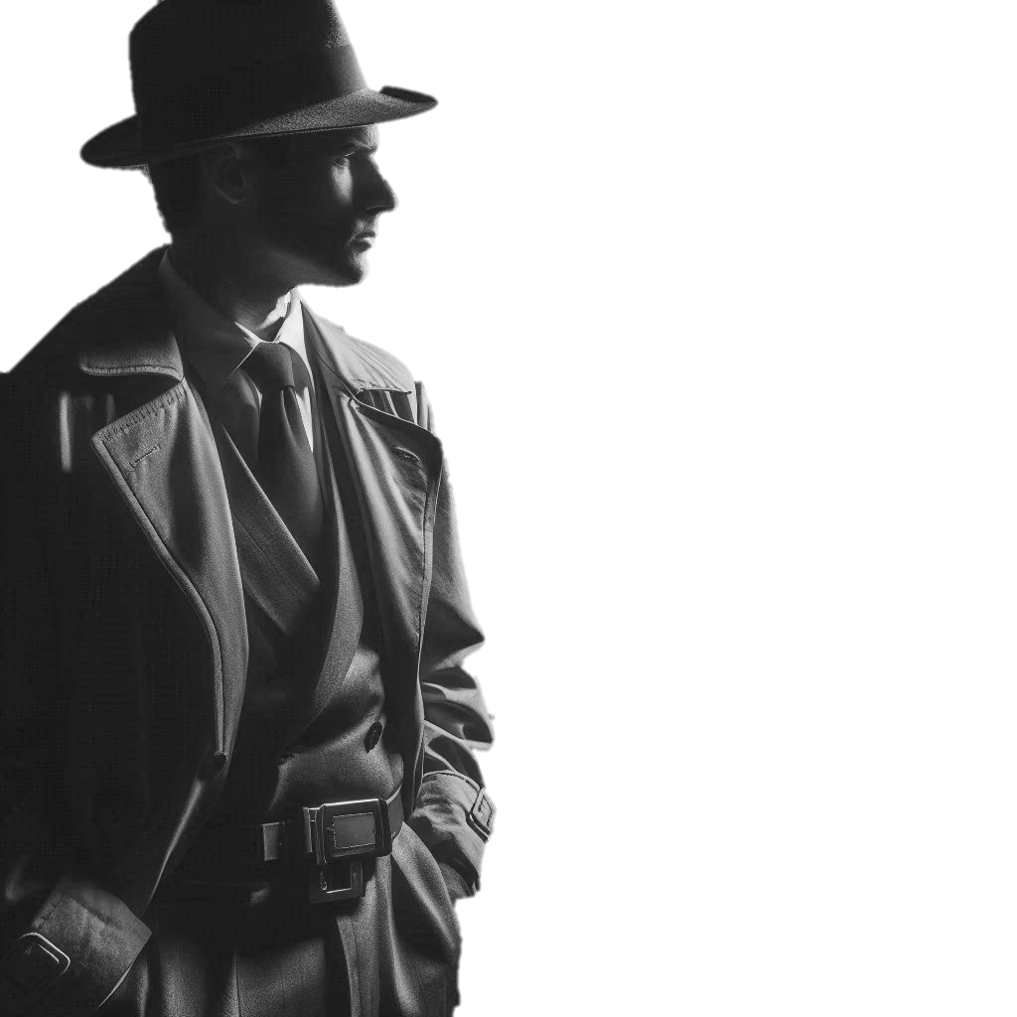

Investigating
Sociology

Slide 4


Investigating
Sociology
Someone clever once told me that “even the longest journey starts with a first step”.
To which I replied “But if you don’t know where you’re going, what’s the point?”.
(They had to admit I was maybe right on that one).
So where are we going?

Slide 5
Investigating
Sociology
When you’ve walked these mean streets as often as me, experience tells you the best place to start is at the beginning.
And the first step to take is to understand what you’re studying.
A wise man once said that.
But enough about me. Let’s get this party started…

Slide 6

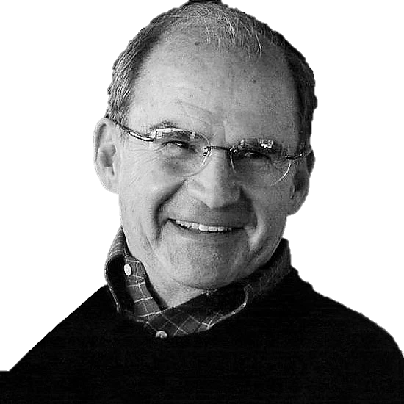

George Ritzer (1940 - )
American academic.
aka
“Big Mac”*
*For reasons that may or may not become clear later.
Much later.
Probably.

Slide 7

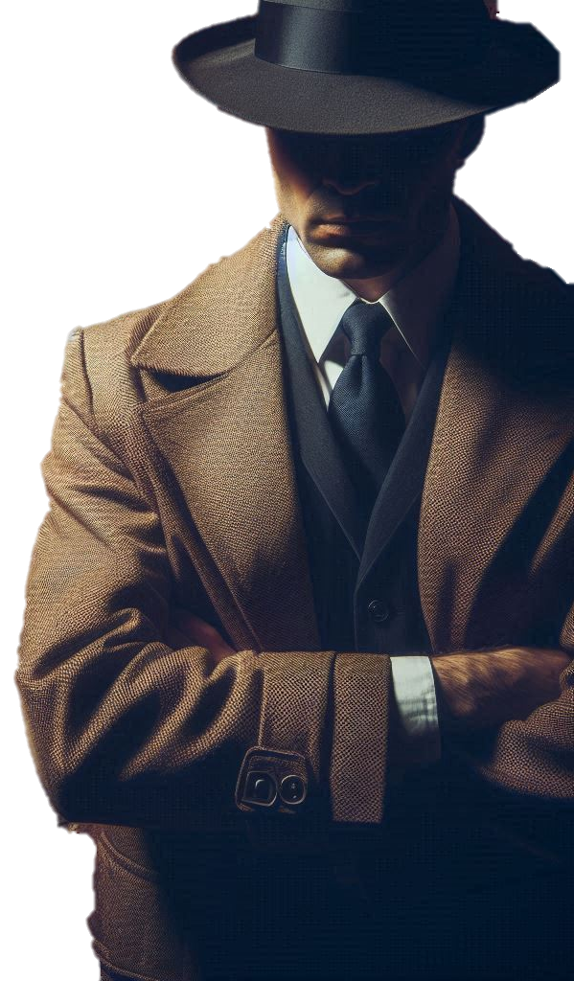
Investigating
George Ritzer
Sociology
Talking Points
“Sociology is the study of individuals in a social setting.”
How do the groups - family, school, friendship, peer and more - to which we belong shape our thoughts and actions?

Slide 8
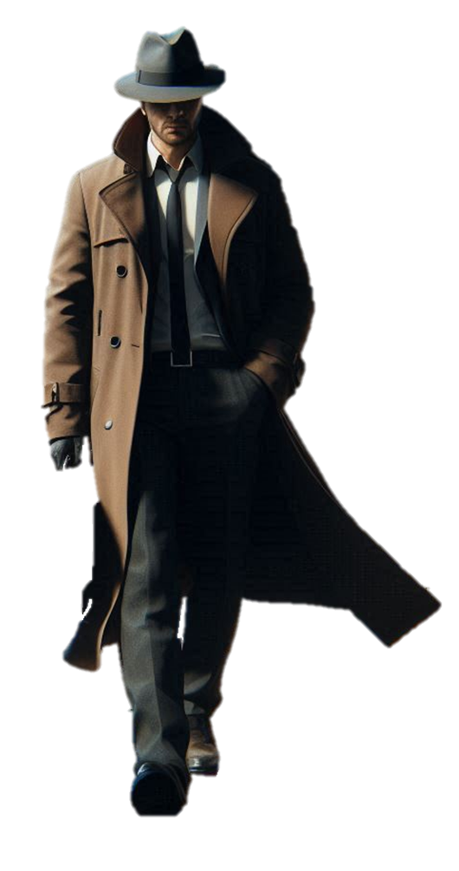

Investigating
Your answers to the previous question should tell you something about what Sociology is:
Sociology
The study of the social forces that shape individual thoughts and actions.
So this is where we place our investigative focus.
Although there could be a problem…

Slide 9
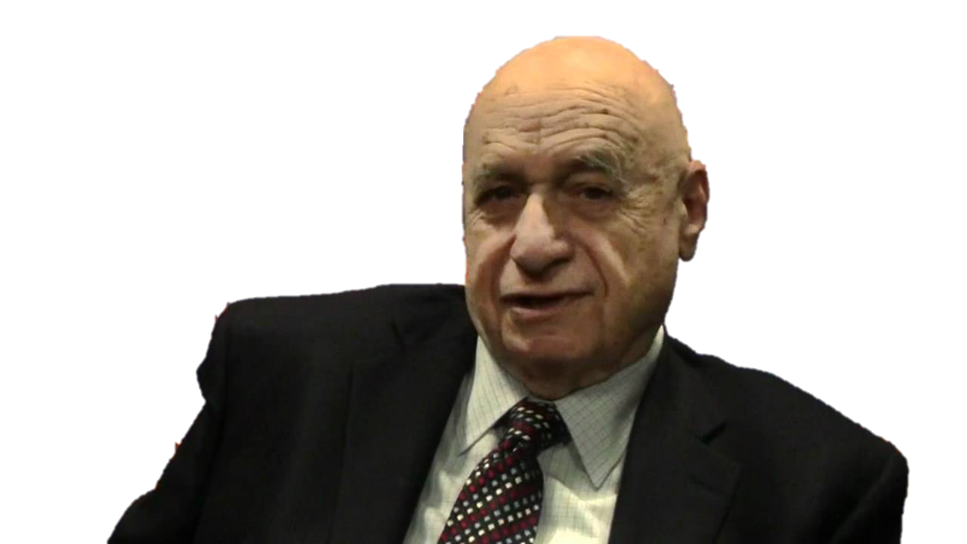
Peter Berger (1929 - 2017)
Invitation to Sociology
“The first wisdom of sociology is this:
Things are never what they seem.”

Slide 10

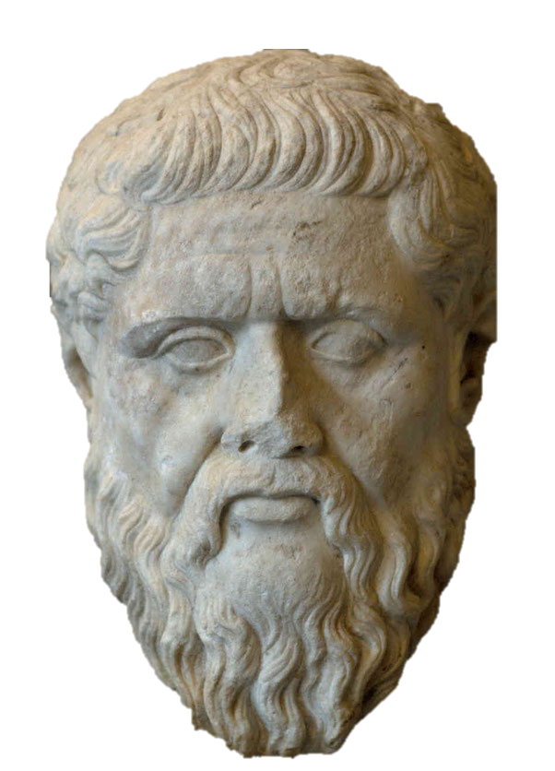
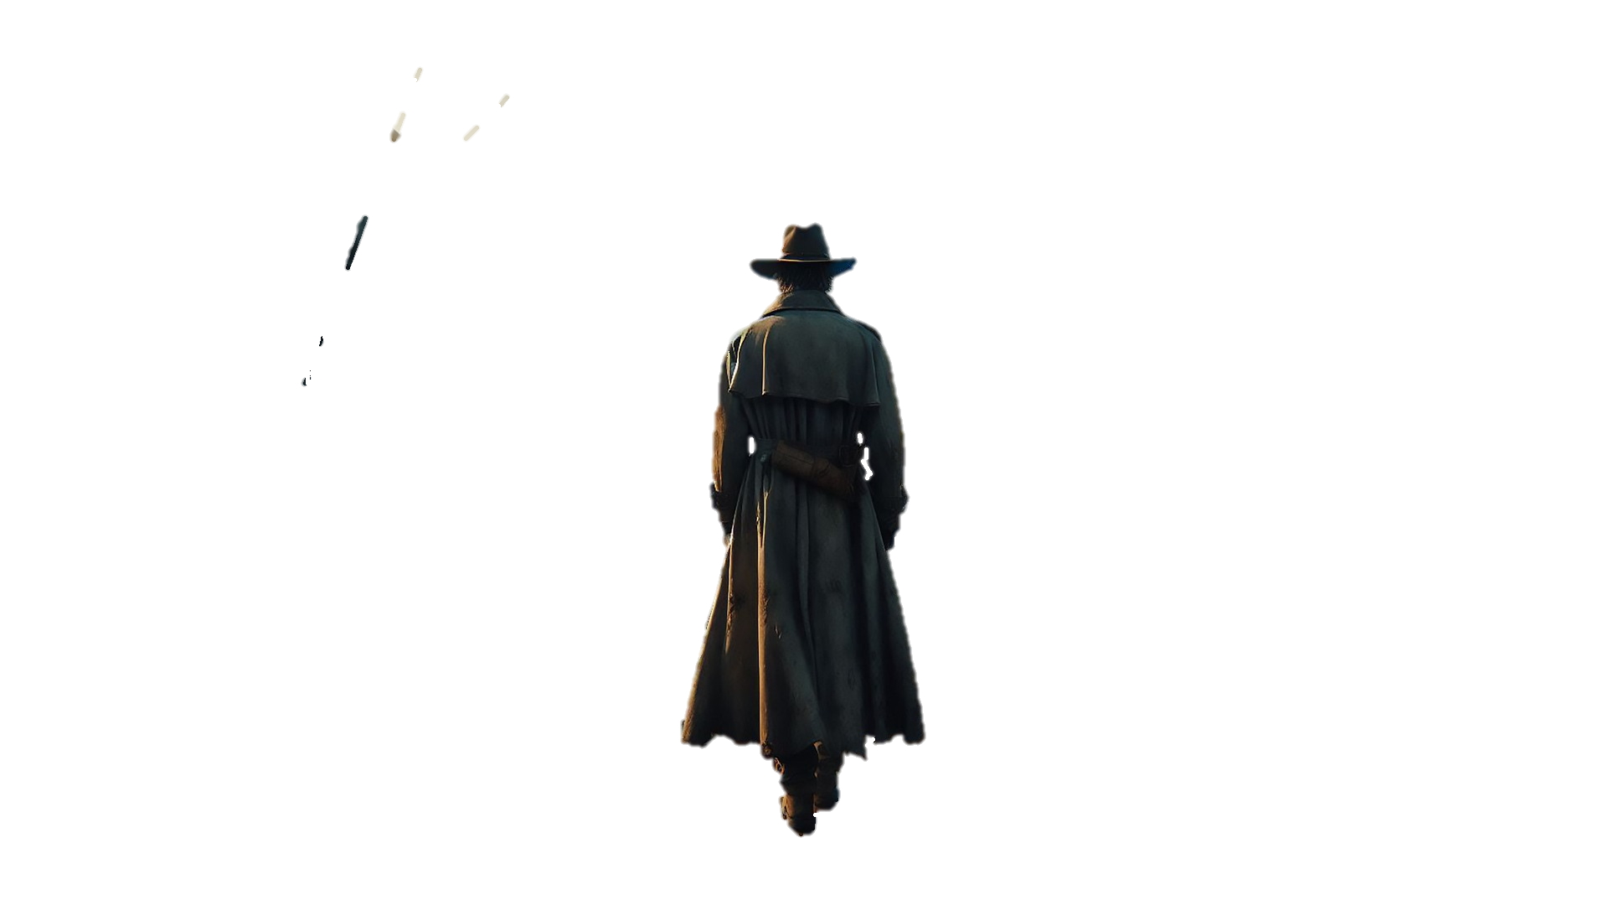
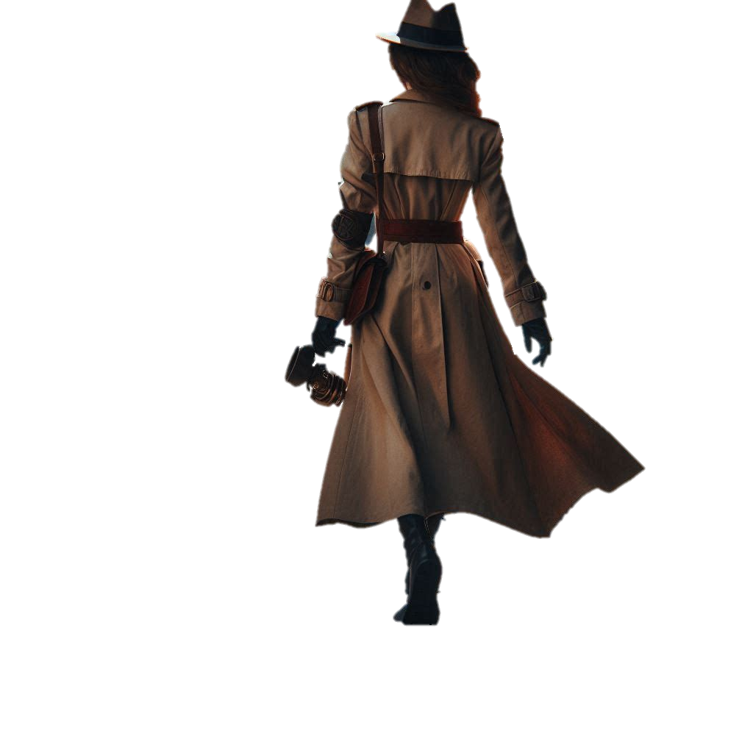
Investigating
Sociology
For the sociologist, the world isn’t “given” to us by external forces like “god” or internal forces such as “instinct”.
It is socially constructed.
And your job is to discover how.
And maybe also why.
(But’s that’s optional for now).
“Things are never what they seem…”.

Slide 11

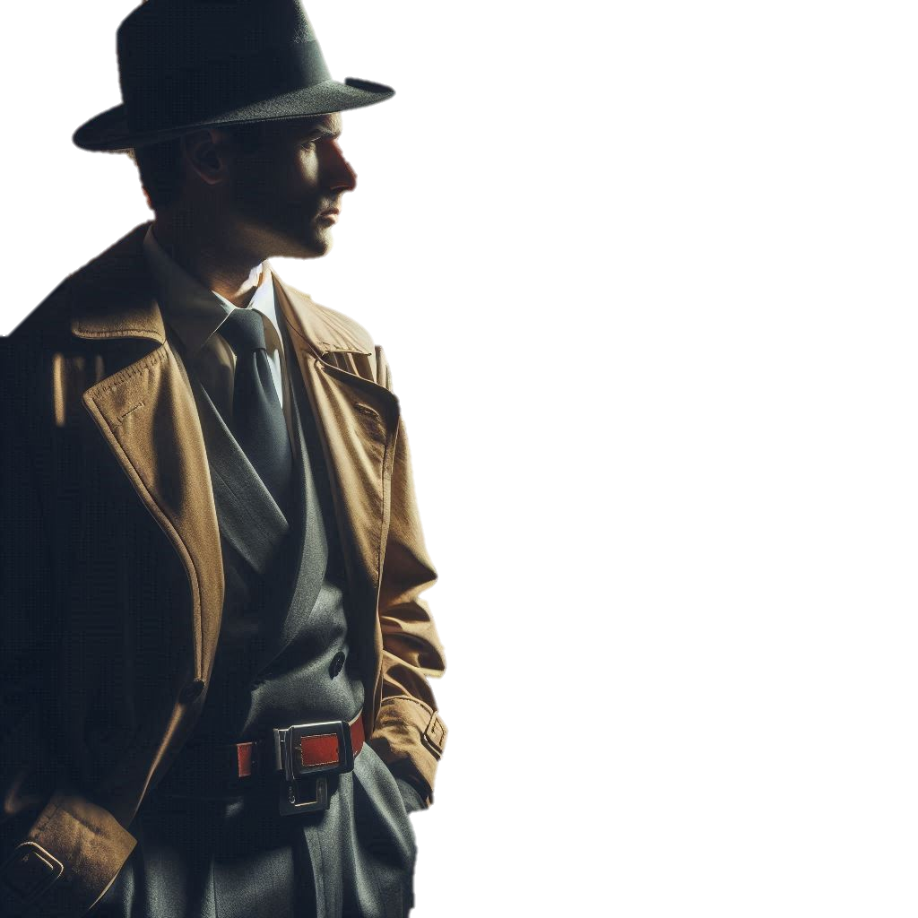

Peter Berger
Investigating
Sociology
“The fascination of sociology lies in the fact that its perspective makes us see in a new light the very world in which we have lived all of our lives”.

Slide 12

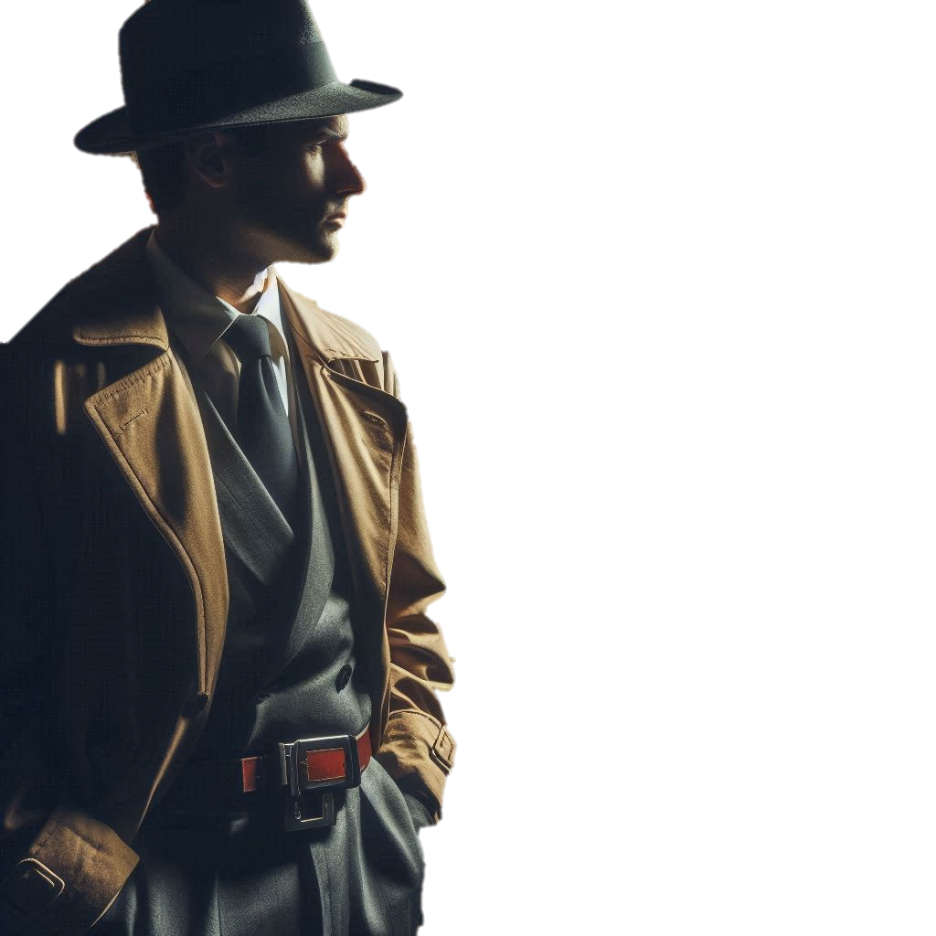
Investigating
What norms exist in your classroom?
Sociology
What happens if you break them?

Slide 13


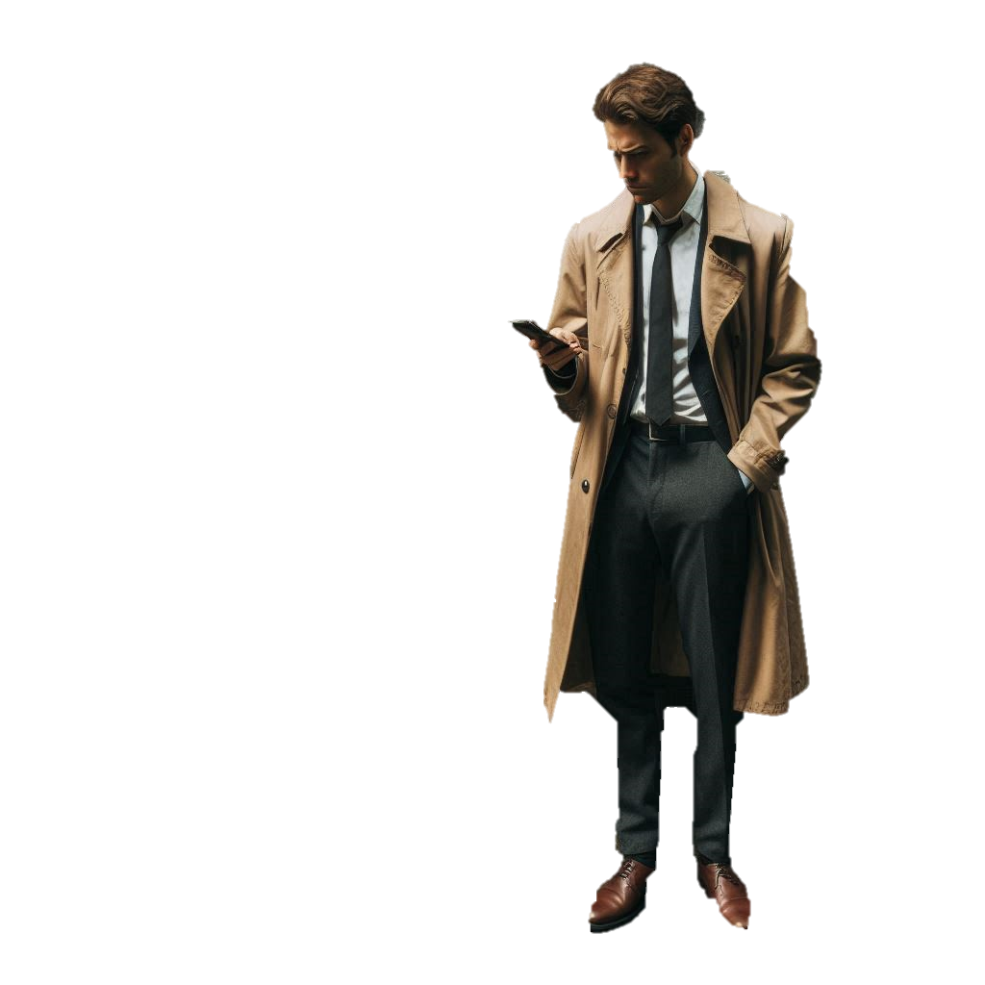
Investigating
Aside from learning about norms, one outcome of that last exercise is the observation that life has rules.
Sociology
But questions about who makes them?, why? and, a personal favourite, who benefits from them? are the kind sociologists are good at asking.
Although it’s not just a case of “looking and learning” in a haphazard way.
The sociological detective is a lot more organised than that…

Slide 14
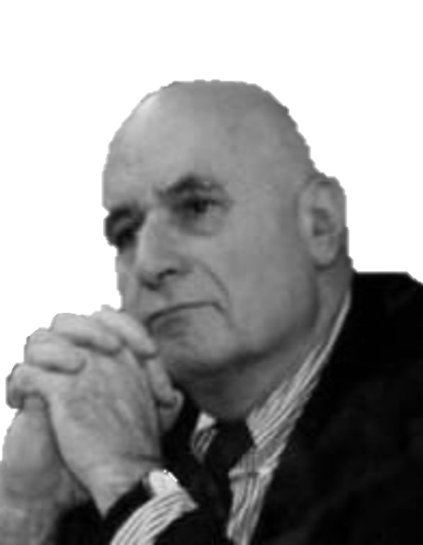
Peter Berger (again)
Invitation to Sociology
“The sociologist is someone concerned with understanding society in a disciplined way. ”

Slide 15

How To Be
a proper Sociological Detective…
Be scientific in your observations.
Be objective: control personal preferences
and prejudices.
Be interested in understanding for its own sake.

Slide 16

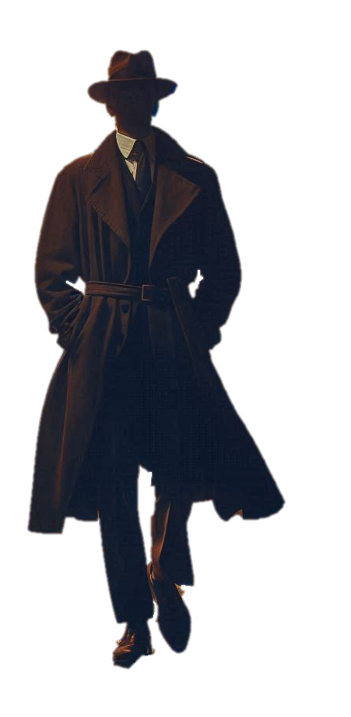
Investigating
Sociology
It’s one thing to be organised - to be systematic and objective in the way you investigate - but there’s another dimension to detection.
It’s an ability not everyone has - but it’s definitely something you can learn.
And for some sociologists it’s the most valuable skill we have...

Slide 17

Michel Foucault (1926 - 1984)
French academic.
And all-round Sociological baldass

Slide 18



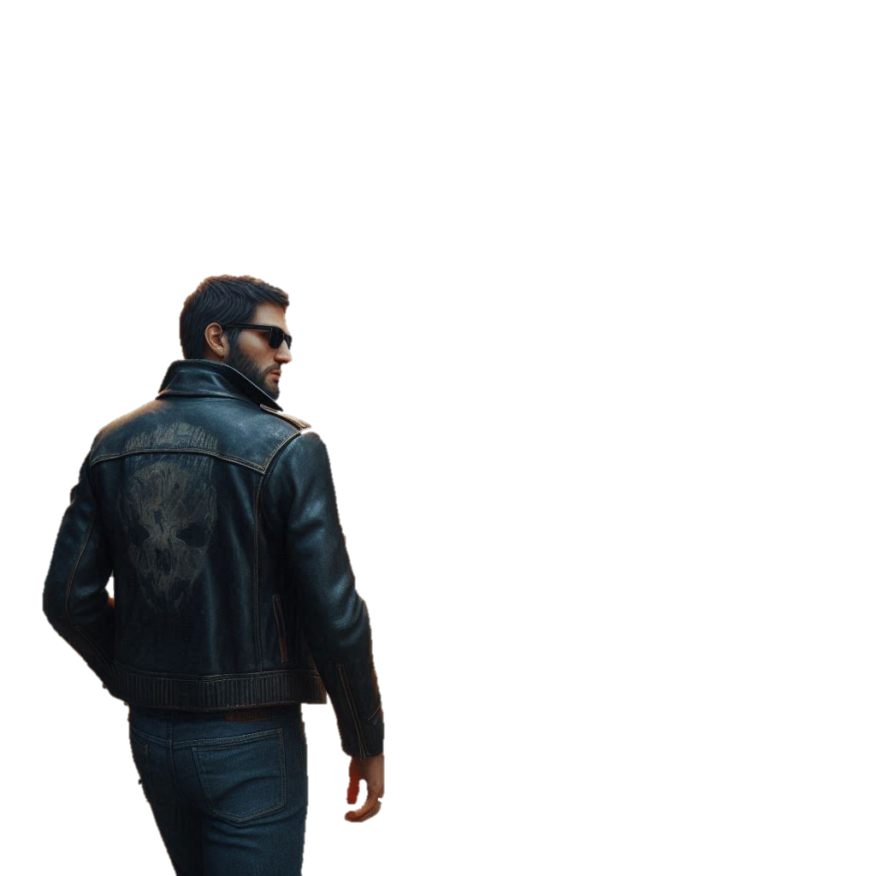
Investigating
Sociology
“People know what they do”
“They frequently know why they do what they do”.
“But what they don’t know is what what they do does”.
And this is the idea we should follow…

Slide 19
Investigating
Sociology
“But what they don’t know is what what they do does”.
People fail, in other words, to understand how their choices have social consequences…
That reflect back on us and shape individual ideas and actions.
And this encourages us to explain people’s behaviour in personal terms…

Slide 20
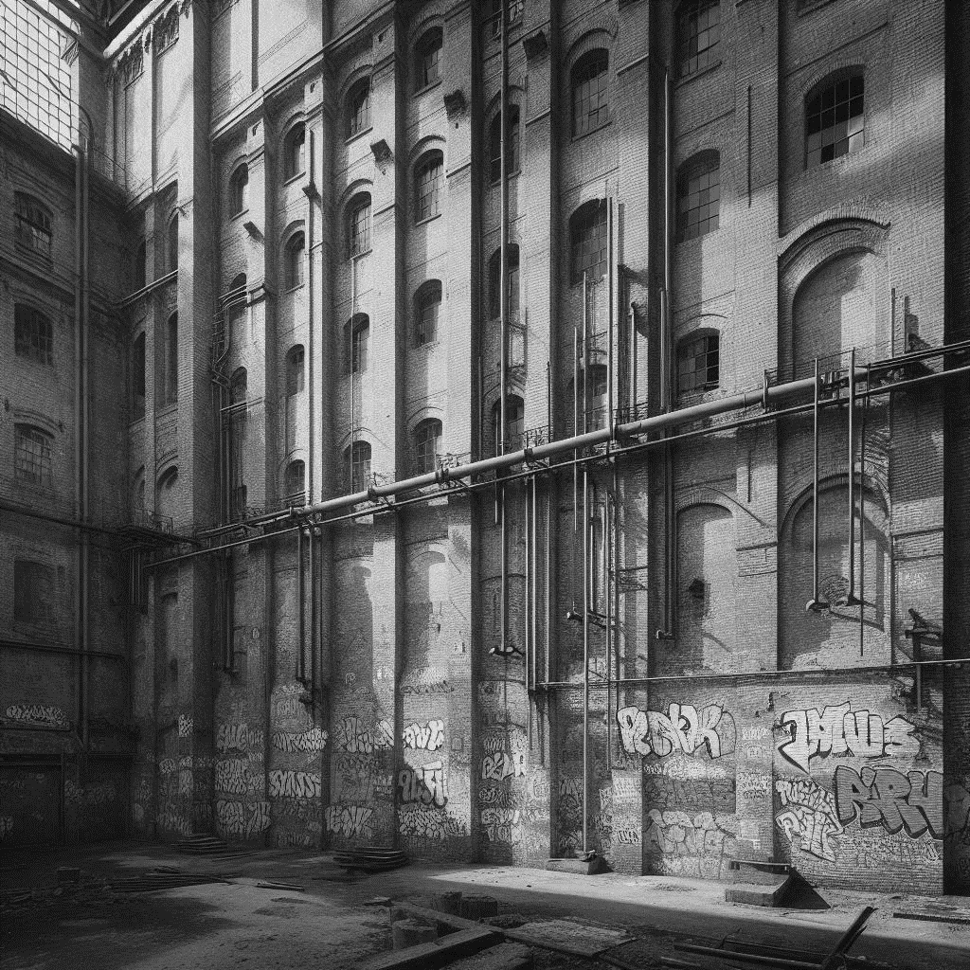
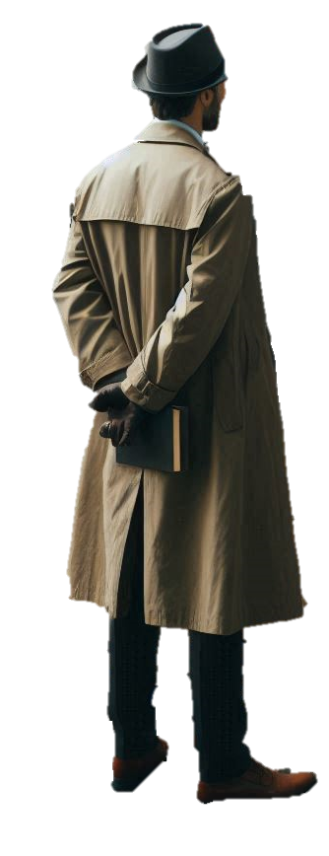


Investigating
Investigating
Sociology
Sociology
And if you don’t believe me?
How do you think most people in our society explain:
Crime?
Educational success?
Divorce?
Poverty?
Affluence?
Religious beliefs?
And how would a sociologist explain them?

Slide 21
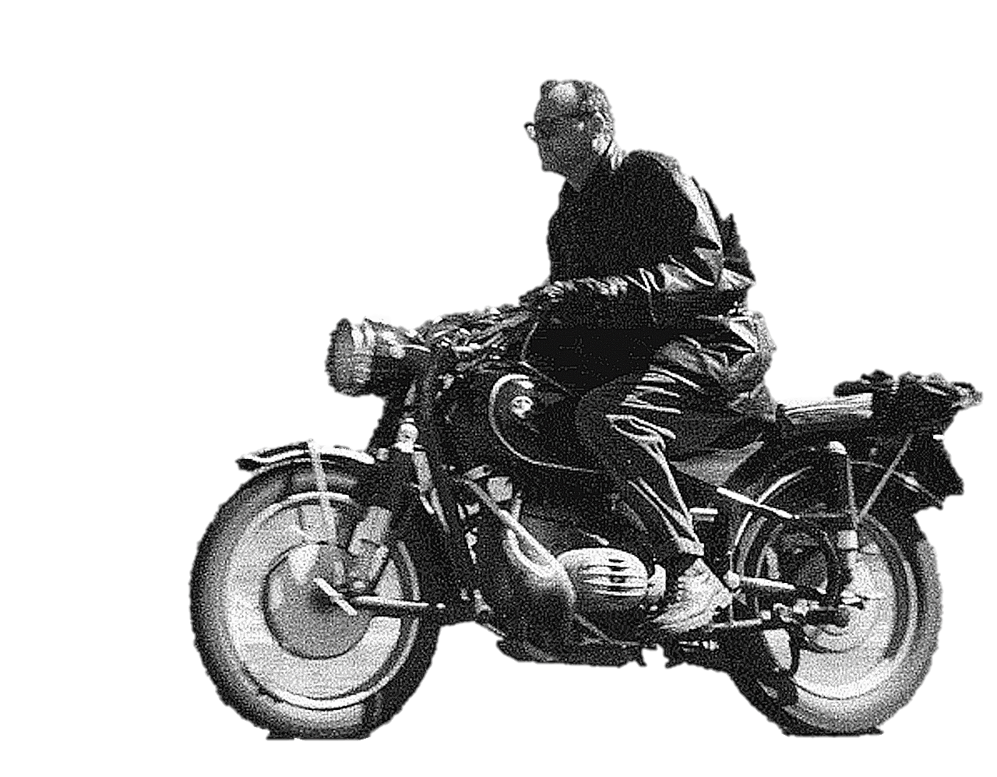
C Wright Mills (1916 - 1962)
The Sociological Imagination
“Neither the life of an individual nor the history of a society can be understood without understanding both”

Slide 22
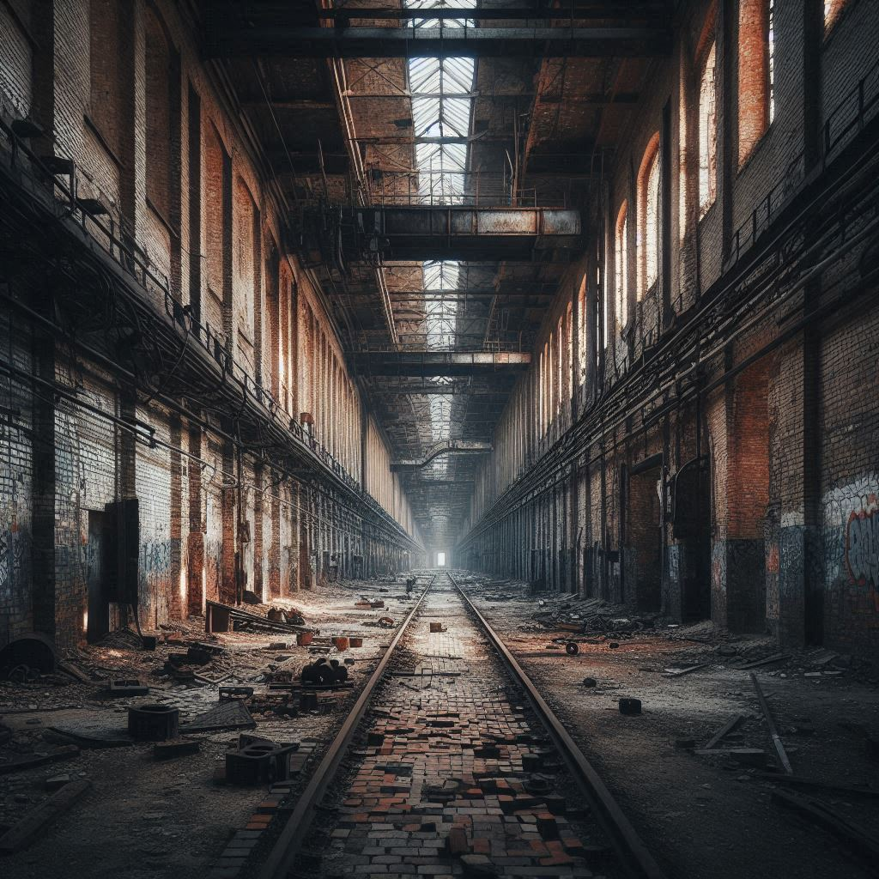
Investigating
Sociology
Sociological investigation involves understanding how the personal and the social interact.
If you can’t have a society without individuals…
Can you have individuals without society?
You may want to take a minute or two to think about it…

Slide 23
Investigating
So, to understand the world we have to look beyond “the individual” and “the personal” to see the Bigger Picture…
Sociology
And that means connecting two ideas:
“The social” that involves understanding how a society has developed historically - and what this means for individuals.
How would your life have been different if you’d been born 200 years ago?
“The biographical” - the unique combination of life events and circumstances that give us our individuality.
How would your life be different if you had been born into a different gender, class or ethnicity?

Slide 24
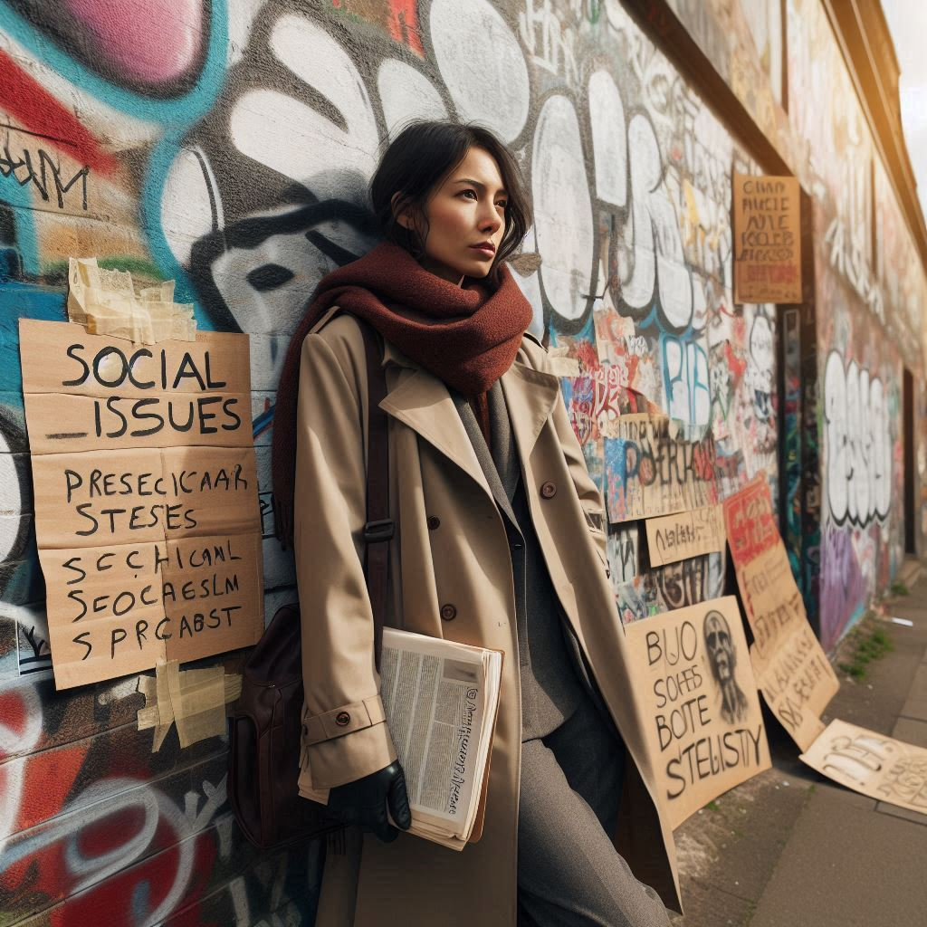

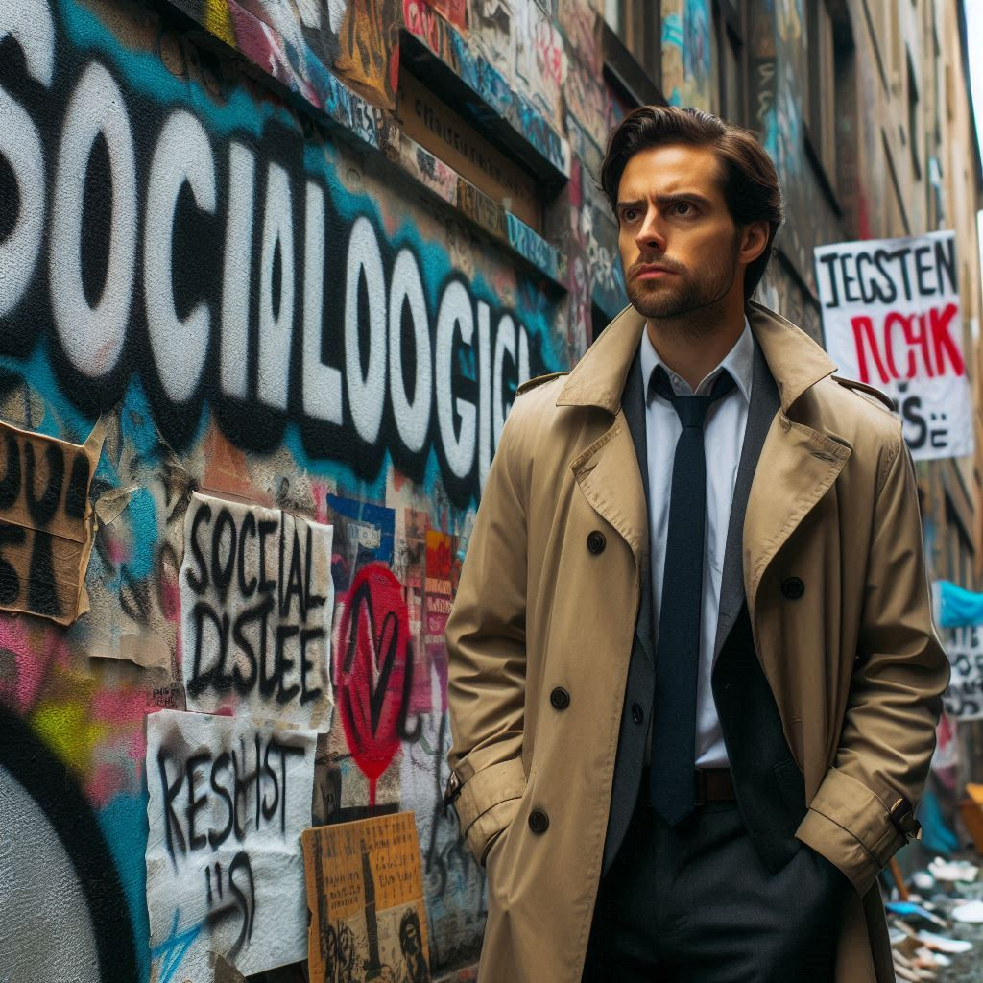
Investigating
Sociology
And our ability to see “The Bigger Picture” depends on developing a range of skills…
Analytical…
Observational…
Critical.

Slide 25

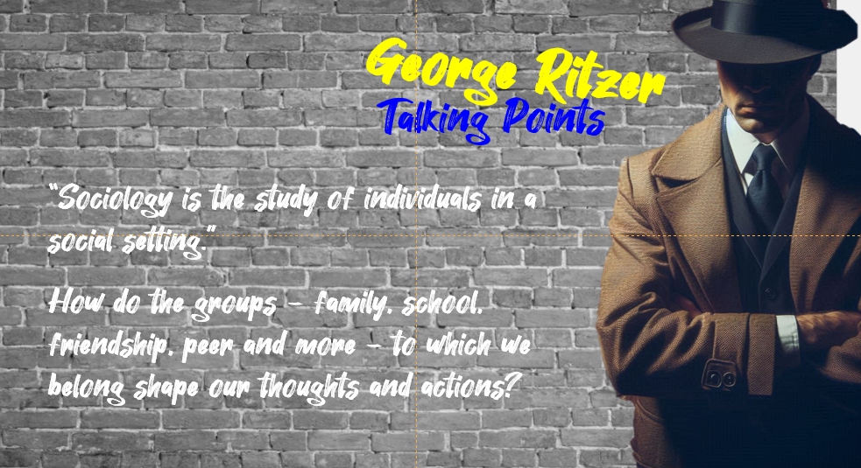
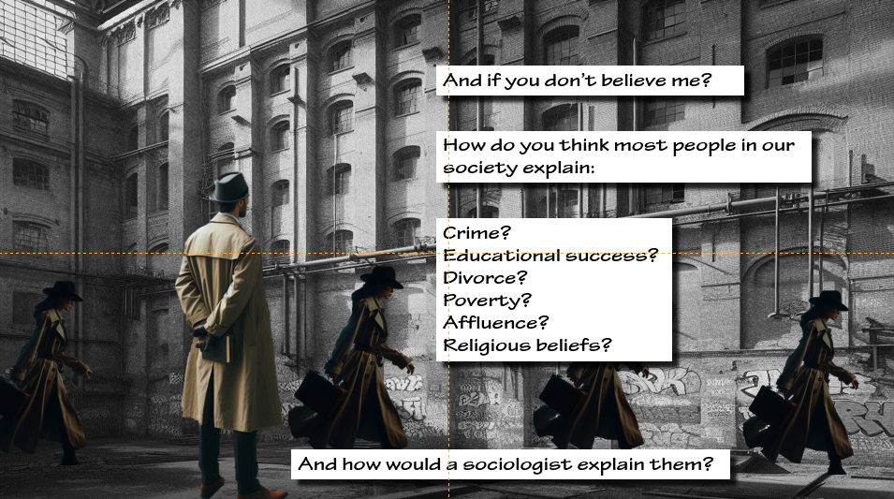
Investigating
Ask questions
Sociology
Think like a detective and unlock your sociological imagination
Apply concepts critically…

Slide 26
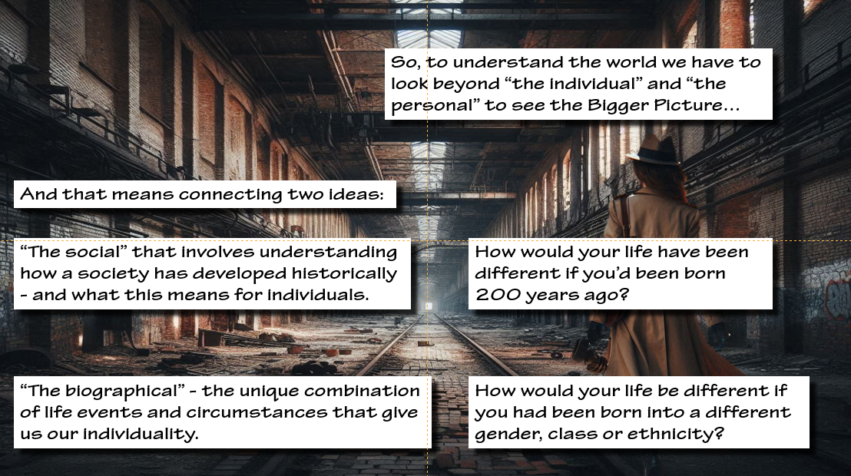
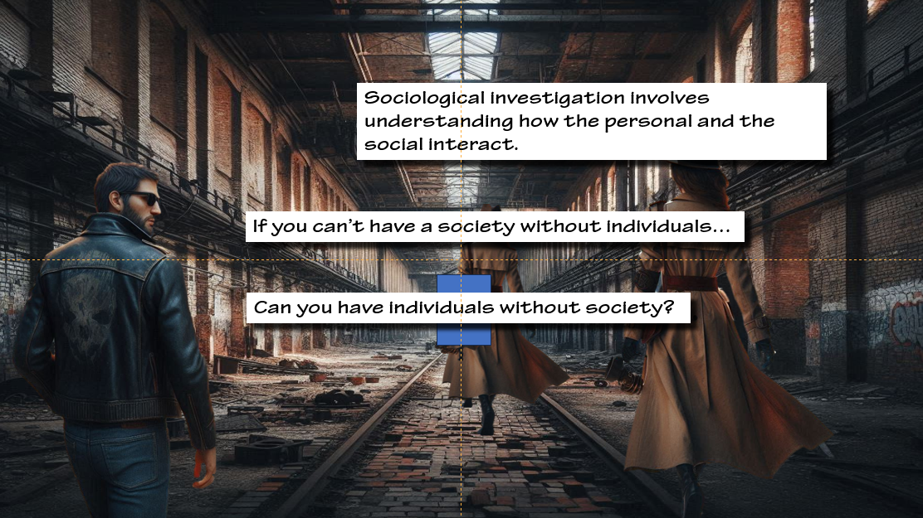
Investigating
Analyse…
Sociology
In terms
Unlock your sociological imagination
Question common assumptions…
Because …

Slide 27
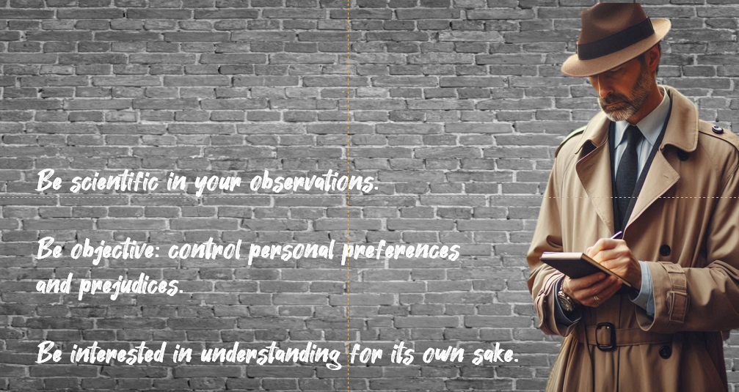
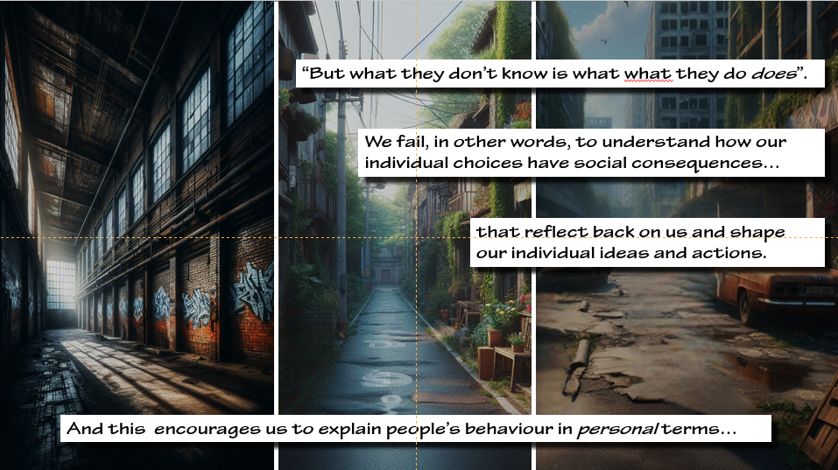
Investigating
Be systematic…
Sociology
Empathise…
Unlock your sociological imagination

Slide 28
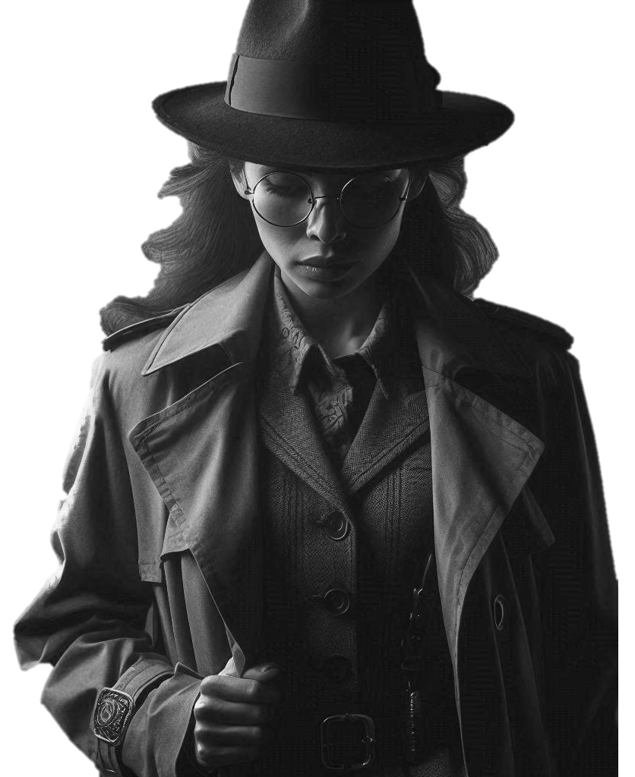

Slide 29
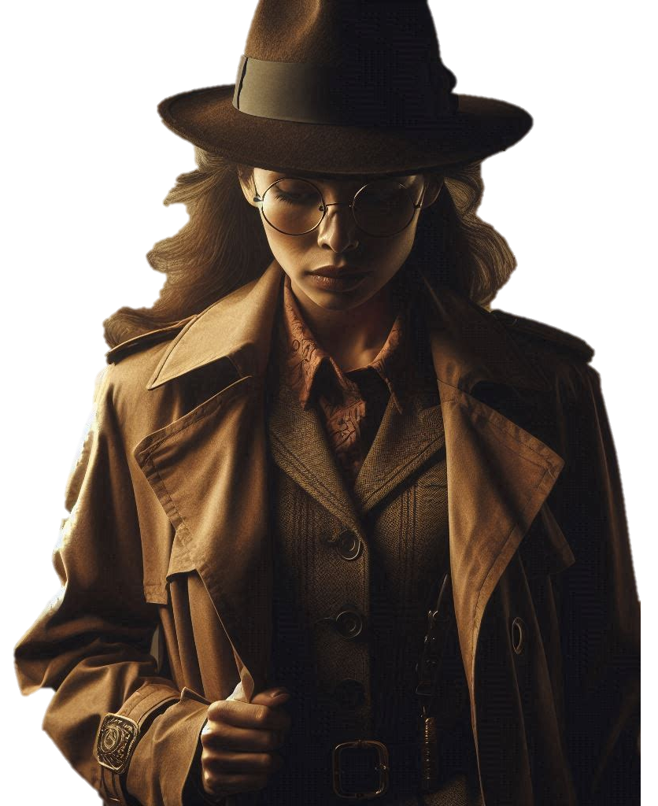
Investigating
Sociology

Slide 30
Written and Designed
(hard to believe I know)
by

Slide 31
Chris Livesey
©2024 shortcutstv.com

